Slide 1
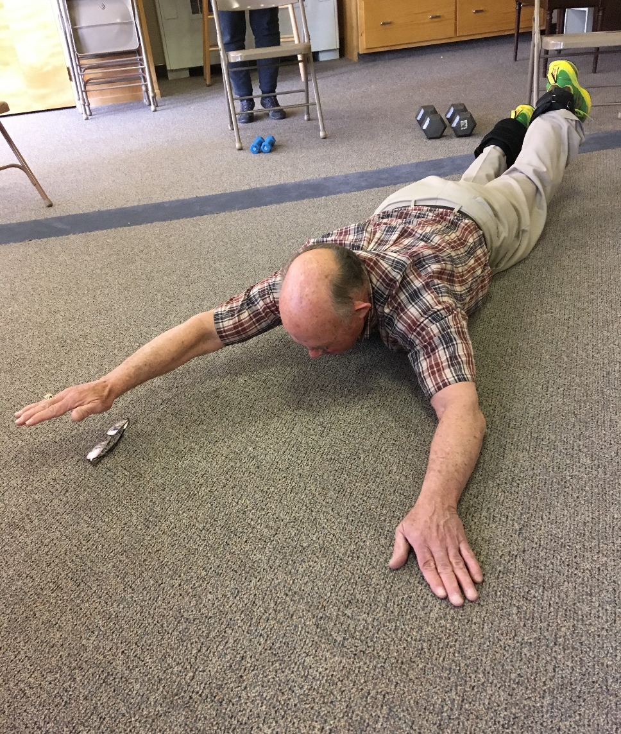
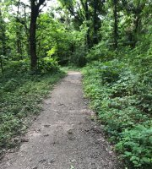


Culture of Health Boot Camp
June 26, 2019
Salina, Kansas

Slide 2


What is Culture of Health?
Good health and well-being flourish across geographic, demographic, and social sectors.
Fostering healthy equitable communities
Guides public and private decision making
Everyone has the opportunity to make choices that lead to healthy lifestyles.
“Everyone deserves to live the healthiest life possible”
Notes:
Culture of Health is broadly defined as one in which good health and well-being flourish across geographic, demographic, and social sectors; fostering healthy equitable communities guides public and private decision making; and everyone has the opportunity to make choices that lead to healthy lifestyles.
Culture of Health will not be achieved by focusing on each action area alone, but by recognizing the interdependence of each area. Implementing the framework will take time and involve collaboration across multiple sectors - beyond the traditional public health field.

Slide 3
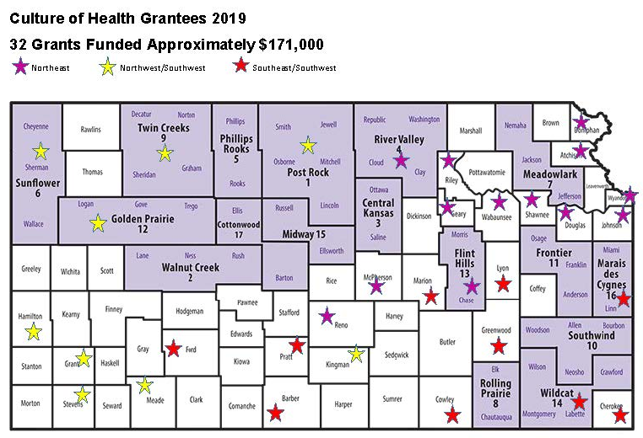
Grantees

Slide 4
Boot Camp outcomes
Increase understanding of:
Policy, Systems, and Environmental (PSE) work
Why PSE work is an important focus for K-State Research and Extension
How to do PSE work
Understand:
Where the strengths and weaknesses are related to PSE as it applies to current COH grants.
How to communicate the impact of PSE work to stakeholders.

Slide 5
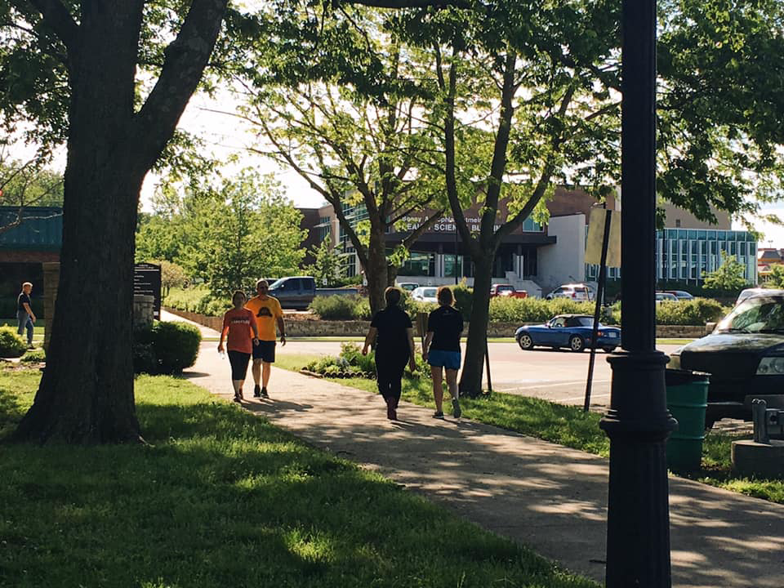
PSE Process
Is ongoing
Produces longer-term behavior change over time
Occurs at the community or population level
Ongoing plan and engages multiple stakeholders
Long-term
Sustainable

Slide 6
Levels of Community Change Game

Slide 7
Levels of Community Change Game
Level Descriptions
Individual—knowledge, skills, attitudes, beliefs, preferences, demographic factors, and personality traits
Group/Social—the support or lack thereof provided by friends, family, and peers, as well as social norms and identity
Organizational—rules, regulations, guidelines, policies, cultures, and structures in place at institutions where people live, work, worship, and play, including the built environment
Policy/System—local, state, and federal policies, laws, and wide-reaching systematic practices
Resource from “Levels of Community Change Game”

Slide 8
7 steps of PSE Change
Step 1: Engage
Step 2: Scan
Step 3: Assess
Step 4: Review
Step 5 : Promote
Step 6: Implement
Step 7: Evaluate
Notes:
Seven Steps for Policy, Systems and Environmental Changes: Worksheets to Actions
George Washington University Cancer Center/ Funded by CDC September 2017
Refer to Page 7 of the PS & E Changes: Worksheets for Action For overview of 7 Steps

Slide 9
7 steps of PSE Change
Step 1: Engage
Step 2: Scan
Step 3: Assess
Step 4: Review
Step 5 : Promote
Step 6: Implement
Step 7: Evaluate
Notes:
Seven Steps for Policy, Systems and Environmental Changes: Worksheets to Actions
George Washington University Cancer Center/ Funded by CDC September 2017
Refer to Page 7 of the PS & E Changes: Worksheets for Action For overview of 7 Steps

Slide 10
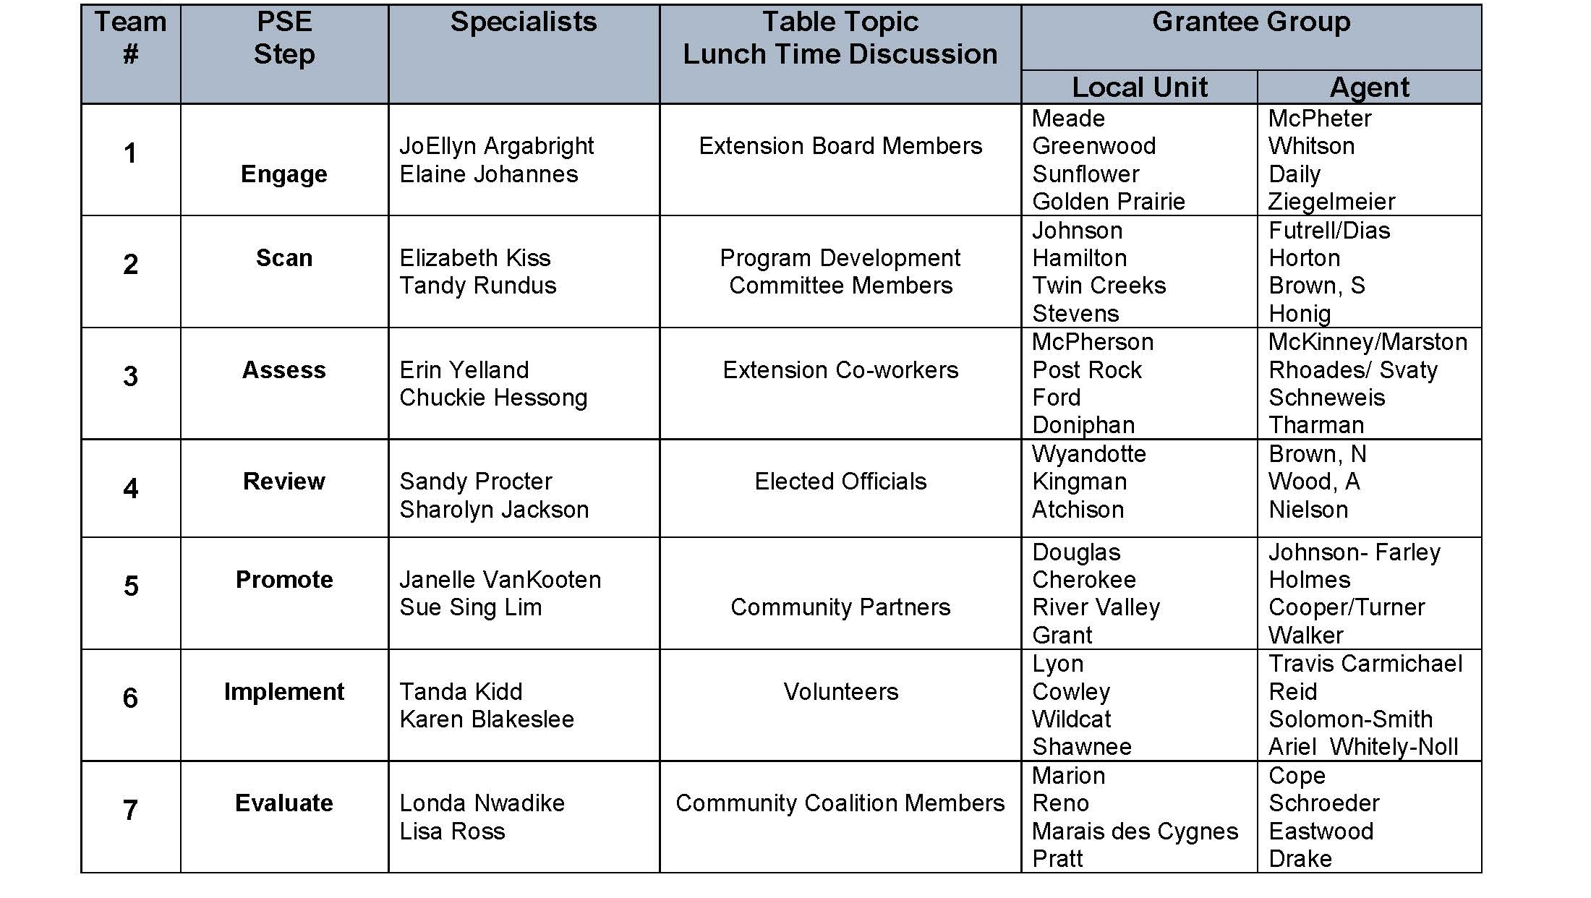
Lunch Discussion
Notes:
Trudy will review “table topic” discussion during lunch.
Set at the Team/Table Assigned
Use discussion sheet and the assigned targeted group for your discussion- Example Team/Group #1 will use the discussion questions and focus there conversation on Extension Board Members.
The specialists assigned to each group/team will facilitate the discussion and record key ideas on the discussion sheet provided.
At the end of lunch, Trudy will asked for a few to report back
Adjourn from Lunch and return to the work table remaining with your assigned Team/Group for the remained of the afternoon.

Slide 11

Step 1: Engage
Build partnerships and engage the community
Notes:
Step 1: Engage – Build partnerships and engage the community
PSE change initiatives involve a wide variety of people, agencies and organizations from all corners of the community, working toward a common goal. As with other public health initiatives, partnerships are vital to any PSE change process. They make it possible to divide the work so it can be completed more efficiently. Working with diverse partners also strengthens efforts by capitalizing on each member’s strengths and reaching each member’s constituencies.

Slide 12

Step 2: Scan
Perform environmental scans
Notes:
Step 2: Scan – Perform environmental scans
An environmental scan can help determine what actions should be taken within the broad health issue you want to address. The environmental scan allows you to identify gaps, trends and factors affecting the political, social, economic and legal contexts to help you understand the drivers of PSE change.

Slide 13
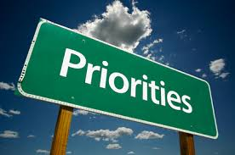
Step 3: Assess
Identify priority areas
Notes:
Step 3: Assess – Identify priority areas
After you have scanned the external environment surrounding the health issue you want to address, you now understand the drivers and challenges of your potential PSE change initiative. However, you need evidence to support your position and the development of SMART objectives. Assess and review available data to determine which specific aspect of the health issue can be potentially resolved or lessened through PSE change.

Slide 14

Step 4: Review
Assess feasibility of interventions
Notes:
Step 4: Review – Assess feasibility of interventions
Once you have developed SMART goals and objectives, review the feasibility of your proposed PSE change intervention to determine if your goals and objectives can be implemented. Work with stakeholders to develop a strategy for turning an idea, goal or objective into action, including a discussion of the political climate and readiness. Ensure that key champions are involved to provide support

Slide 15

Step 5: Promote
“Promote awareness, communicate and educate”
Notes:
Step 5: Promote – Promote awareness, communicate and educate
You are ready to communicate the need for your PSE change effort. Communicate to all stakeholders the need for PSE change prior to implementation to help lessen potential resistance. Incorporate various forms of media to educate and build support from stakeholders and the public, when appropriate.

Slide 16

Step 6: Implement
Take action
Notes:
Step 6: Implement – Take action
The first five steps of the PSE change process lead to the implementation of your PSE change intervention. Carry out PSE change activities that link directly with goals and objectives in your cancer control plan.

Slide 17

Step 7: Evaluate
Measure your success
Notes:
Step 7: Evaluate – Measure your success
Evaluate the processes employed during the implementation of your PSE change intervention, as well as the short-term, intermediate and long-term outcomes expected to result from the intervention. Evaluation can provide quantitative and qualitative data to demonstrate the change(s) that occurred.

Slide 18

Reflections
What’s Next?
Notes:
Paula-
Reflections from today
Next Step- Identify “1” action step for each of the 7 PSE Change Steps to enhance COH work. Discuss/share with assigned regional/state mentor specialist by August 12.
COH Grant PEARS Reporting- First Quarterly Report ( April – June 2019)- Impact Statements and Success Stories
Final Project Report r
Next Up- COH Grantee PEARS Reporting Regional Training- August 13, 2019 Hays, Manhattan, Parsons, Dodge City

Slide 19


Policy, Systems, and Environmental Change
In a Culture of Health, everyone has the opportunity to live a healthier life, no matter who we are, where we live, or how much money we make.

Slide 20
Resources
George Washington University- Action 4 PSE Change
  http://action4psechange.org/
Action for PSE Change: A Training – It provides background information on the 7-step PSE change process, stepwise worksheets, a PSE action plan template, real-world examples from comprehensive cancer control programs, an extensive resource list and theoretical and evaluation approaches to help grow the PSE change evidence base. http://action4psechange.org/resources-and-tools/
Levels of Community Change Game- Ohio State University- https://ohio4h.org/changegame

Slide 21
Culture of Health Boot Camp
Boot Camp Planning Team:
  Dr. Elaine Johannes
  Dr. Elizabeth Kiss
  Dr. Erin Yelland
  Dr. Londa Nwadike
  Tandy Rundus
  Trudy Rice
  Gayle Price
Culture of Health Resources
https://www.ksre.k-state.edu/fcs/cultureofhealth.html
June 26, 2019

