Slide 1
Annual Training for Farm Supervisors
The FSMA Produce Safety Rule §112.21

Slide 2
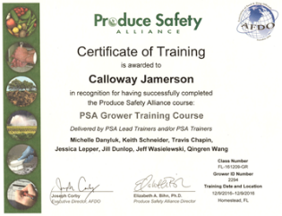
Who is this training for?
This training was designed for supervisors who have already completed the Produce Safety Alliance Grower Training. The curriculum was designed to address the annual training requirement outlined in §112.21 of the Produce Safety Rule (PSR).
Notes:
This training DOES NOT satisfy §112.22(c) of the Produce Safety Rule requiring at least one supervisor or responsible party from a farm subject to the rule successfully complete a standardized food safety training. For more information on the curriculum recognized by FDA visit https://producesafetyalliance.cornell.edu/

Slide 3
Training Topics
Domesticated and Wild Animals
Agricultural Workers & Visitors
Vestibulum congue tempus
Vestibulum congue tempus
Equipment, Tools, & Buildings
Vestibulum congue tempus
Biological Soil Amendments of Animal Origin
Agricultural Water
Vestibulum congue tempus
Vestibulum congue tempus
All agricultural water must be safe and of adequate sanitary quality for its intended use
Any soil amendment intentionally added to the soil that contains an animal ingredient
Understanding the risks from animals and proper mitigation strategies
How to train your workers and handle visitors to ensure good hygienic practices
Adequate facilities, tools, and sanitation to prevent contamination
1
2
3
2
3
4
4
5
1
5
Notes:
This training DOES NOT cover Subpart M of the Produce Safety Rule – Sprouts. For more information on sprout training visit https://www.ifsh.iit.edu/ssa

Slide 4
Agricultural Water

Slide 5
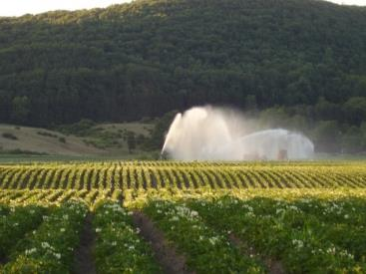
Agricultural Water
Agricultural water means water that comes into direct contact with produce covered by the FSMA PSR or food contact surfaces. All agricultural water must be safe and of adequate sanitary quality for its intended use.
Image Credit: Produce Safety Alliance
Notes:
Subpart E – Agricultural Water §112.41
Image courtesy of Produce Safety Alliance.

Slide 6
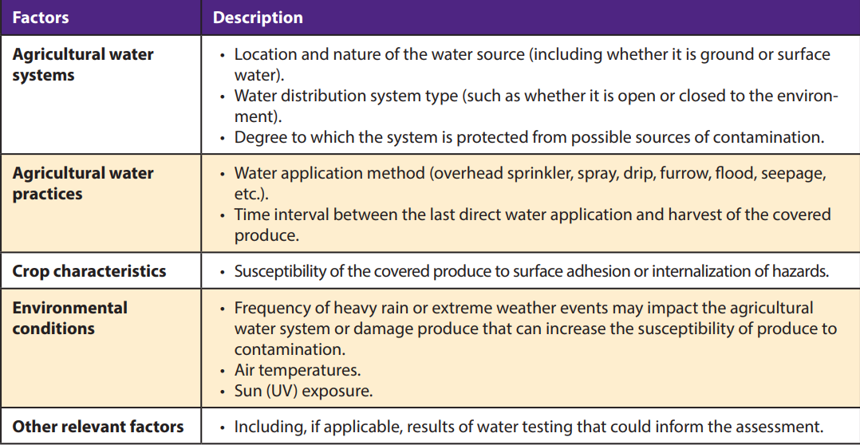
Proposed Subpart E Revision
December 2021 proposed revision to Subpart E published
Replace microbial criteria and testing requirements for pre-harvest agricultural water with pre-harvest agricultural water systems assessments
Review New Modified FSMA PSR Agricultural Water Requirements Proposal
Image Credit: Yeqi Zhao, KSU
Notes:
https://bookstore.ksre.ksu.edu/pubs/MF3642.pdf

Slide 7
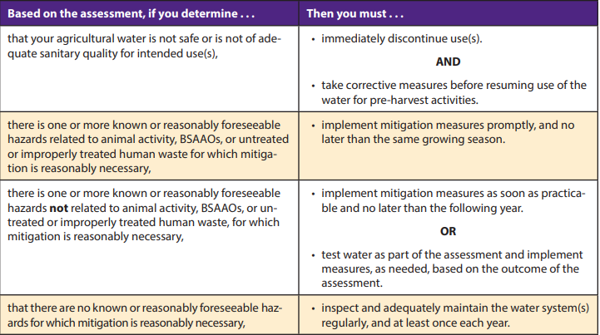
Proposed Subpart E Revision
Establishes exemptions and exclusions
SNPRM (July, 2022) proposed staggered compliance dates depending on business size after pre-harvest rule is finalized
Harvest and Post-harvest requirements are in effect for some farms (link in notes)
Image Credit: Yeqi Zhao, KSU
Notes:
https://bookstore.ksre.ksu.edu/pubs/MF3642.pdf
https://www.fda.gov/food/food-safety-modernization-act-fsma/requirements-harvest-and-post-harvest-agricultural-water-subpart-e-covered-produce-other-sprouts

Slide 8
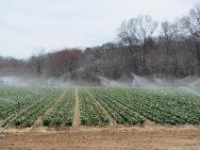
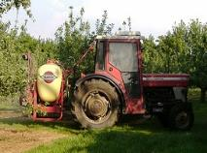
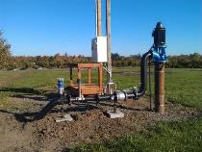
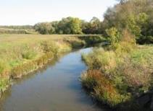
Production Water
Production water refers to water used for growing produce - irrigation, fertigation, foliar sprays, frost protection, etc.
The risk varies significantly depending on the water source (municipal, well, or surface) and application method (drip, overhead, flood, seepage, etc). Once you know more about your water source and potential risks, testing will help you better understand its quality.
Image Credits: Produce Safety Alliance
Notes:
Images courtesy of Produce Safety Alliance.

Slide 9
Example Risks to Surface Water
Septic Tank Leakage
Agricultural Runoff
Waste Water Discharge
Manure Application/ Composting Operations
Urban and Environmental Runoff
Surface Water Source
Wildlife & Domesticated Animal Feces
Things We Never Thought Of
Image Credit: Produce Safety Alliance
Notes:
Produce Safety Alliance Grower Training.

Slide 10
Example Risks to Ground Water
Well Construction
Topography
Aquifer
Soil Characteristics
Livestock
Ground Water Source
Depth
Things Never Thought Of
Image Adapted from: Produce Safety Alliance
Notes:
Well Construction: location not subject to flooding, upslope, watertight casing, sanitary seal or cap, and backflow prevention.

Slide 11
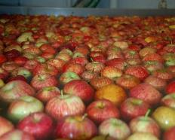
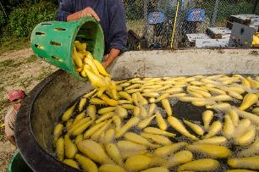
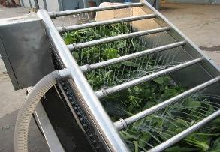
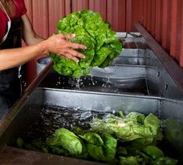
Postharvest Water
Postharvest water refers to water used during and after harvest - rinsing, washing, flumes, dump tanks, cooling, ice making, wax, cleaning, hand washing, etc.
Image Credits: Produce Safety Alliance
Notes:
Images courtesy of Produce Safety Alliance

Slide 12
Postharvest Water-Enforcement Discretion
Enforcement discretion has ended for harvest and postharvest water requirements for all farms covered by FSMA, other than “very small businesses” as listed below (adjusted for inflation)
No detectable generic E. coli in 100 mL water for postharvest water
Business Size | Water Related Enforcement Dates
All other businesses (>$500K) | January 26, 2023
Small businesses (>$250K-500K) | January 26, 2024
Very small businesses (>$25K-250K) | January 26, 2025
Image Credit: Produce Safety Alliance

Slide 13
Postharvest Water Management
There are two critical factors for harvest and postharvest water management
The water quality at the start of use
Water management strategies to reduce cross-contamination risks
Antimicrobial products (sanitizers) are an effective method for maintaining adequate water quality. Although not explicitly required in the FSMA PSR, sanitizers are a best practice for reducing cross-contamination risks and to meet the FSMA PSR water quality standards. Sanitizers are not intended to “wash” the produce to make it clean - sanitizers prevent cross-contamination of produce. There are organic sanitizers available.
Remember sanitizers must be labeled for their intended use!
Image Credit: Produce Safety Alliance

Slide 14
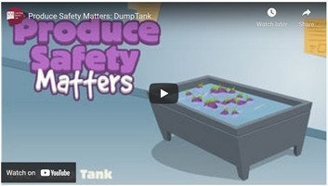
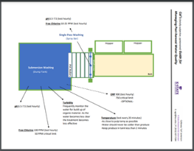
Postharvest Water Management
Watch the dump tank management video from New Mexico State University
2) Review the K-State Postharvest Water Guide
Notes:
https://www.ksre.k-state.edu/foodsafety/produce/guidance/index.html#agricultural-water
https://www.ksre.k-state.edu/foodsafety/produce/guidance/docs/Managing-Post-Harvest-Water.pdf

Slide 15
Agricultural Water Resources
PSA factsheet on selecting a labeled sanitizer
PSA sanitizer web tool
University of Missouri Extension video on sanitizer basics
K-State Research & Extension videos on water testing
Annual water system inspection questionnaire
Notes:
https://resources.producesafetyalliance.cornell.edu/documents/Sanitizer-Factsheet.pdf
https://resources.producesafetyalliance.cornell.edu/sanitizer/
https://www.ksre.k-state.edu/foodsafety/produce/guidance/index.html#sanitation
https://www.ksre.k-state.edu/foodsafety/produce/guidance/index.html#water-testing
https://www.ksre.k-state.edu/foodsafety/produce/usda-gap/doc/LOG-Water-Annual.pdf

Slide 16
Biological Soil Amendments

Slide 17
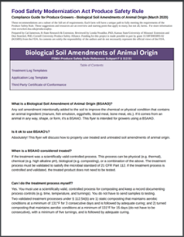
Biological Soil Amendments
The FSMA PSR focuses on Biological Soil Amendments of Animal Origin (BSAAO). Any soil amendment intentionally added to the soil to improve its condition that contains an animal ingredient (such as manure or fish emulsion) is a BSAAO.
Review the Biological Soil Amendments of Animal Origin Compliance Guide
Notes:
Subpart F – Biological Soil Amendments of Animal Origin and Human Waste §112.51
https://www.ksre.k-state.edu/foodsafety/produce/fsma/docs/Bsaao.pdf

Slide 18
BSAAO Resources
NCR factsheet on FSMA compliant On-Farm Thermophilic Composting
FDA factsheet on Biological Soil Amendments of Animal Origin
Michigan State University Extension video on safe use of BSAAO
Notes:
https://www.ncrfsma.org/files/page/files/ncr_bsaao_final.pdf
https://www.fda.gov/media/114775/download
https://www.youtube.com/watch?v=yJN29Aeh24o

Slide 19
Domesticated and Wild Animals

Slide 20
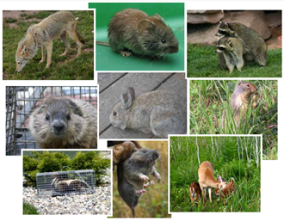
Wildlife
If there are reasonable circumstances that contamination could occur from wildlife - almost always the case - you must assess the areas during the growing season.
It is not possible to completely exclude wildlife from production areas and that is not the expectation - knowing your risks from wildlife and taking steps to mitigate contamination risks is the expectation.
Image Credits: Montana State University
Notes:
Subpart I – Domesticated and Wild Animals §112.81
Image courtesy of Montana State University.

Slide 21
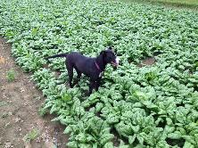
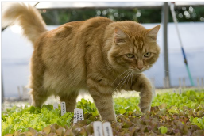
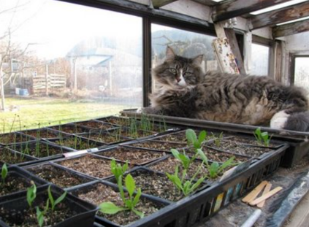
Domesticated Animals
The FSMA PSR applies to domesticated animals
Examine the hypothetical is one cat better than 100 mice?
Image Credits: Produce Safety Alliance, Michigan State University Extension Agrifood Safety, and Cakehead Loves Evil
Notes:
Images courtesy of Produce Safety Alliance, Michigan State University Extension Agrifood Safety, Dreamstime, and Cakehead Loves Evil.

Slide 22
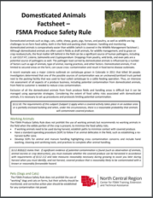
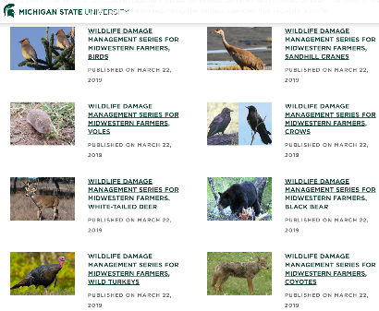
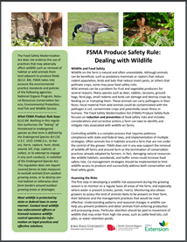
There are guidance documents on managing risks from domesticated and wild animals.
Notes:
https://www.ksre.k-state.edu/foodsafety/produce/docs/dealing-with-wildlife.pdf
http://animalrange.montana.edu/documents/extension/WILDLIFEDAMAGECONTROLFORORGANICFARMERS.pdf
https://www.ksre.k-state.edu/foodsafety/produce/docs/NCR-Domesticated-Animals-Factsheet.pdf
https://www.canr.msu.edu/ipm/wildlife-management/
https://www.ksre.k-state.edu/foodsafety/produce/guidance/index.html#wildlife-rodents-pest

Slide 23
Field Assessments
1) You must take measures reasonably necessary during growing to assist you later during harvest when you must identify, and not harvest, produce that is reasonably likely to be contaminated with a known or reasonably foreseeable hazard.
2) Identifying and not harvesting covered produce that is reasonably likely to be contaminated with animal excreta or that is visibly contaminated with animal excreta requires a visual assessment of the growing area to be harvested, regardless of the harvest method used.

Slide 24
Agricultural Workers & Visitors

Slide 25
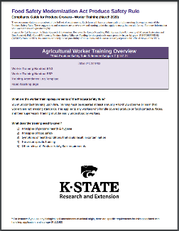
Agricultural Workers
All personnel who handle covered produce or food contact surfaces must receive training upon hiring and at least annually.
Review the Worker Training Compliance Guide
Notes:
Subpart C – Personnel Qualifications and Training §112.21
Subpart D – Health and Hygiene §112.31
https://www.ksre.k-state.edu/foodsafety/produce/fsma/docs/compliance-guide-worker-training.pdf

Slide 26
Wash Your Hands!
Wet hands with water.
Apply soap and lather — be sure to wash the front and backs of hands as well as in between fingers, rubbing for at least 20 seconds.
Rinse hands thoroughly with potable water.
Dry with a paper towel.
Turn off faucet with used paper towel.
When you MUST Wash Your Hands
After using the restroom.
Before starting or returning to work.
Before and after eating or smoking.
Before putting on gloves.
After touching animals or animal waste.
Anytime your hands become contaminated.
Wet Hands
Soap
Wash for 20 seconds
Rinse
Dry
Turn off water with paper towel
From K-State’s Worker Training Compliance Guide

Slide 27
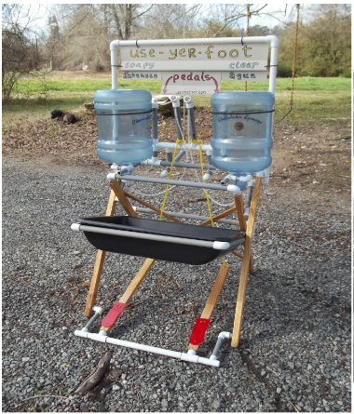
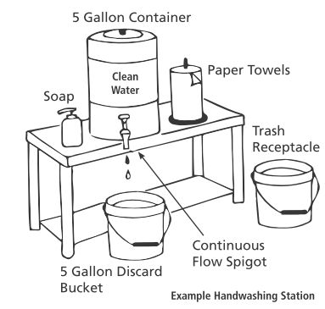
Portable Hand Washing Station
What about grey water? There are different rules and regulations on collection and dumping (state and local), so reach out to Extension personnel for guidance. For the FSMA PSR, do not drain or dump near traffic, fields, or irrigation sources.

Slide 28
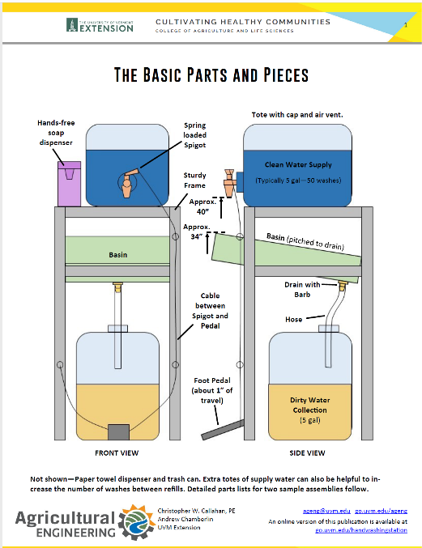
Portable Hand Washing Station
Notes:
https://blog.uvm.edu/cwcallah/2020/06/09/improving-handwashing-stations/

Slide 29
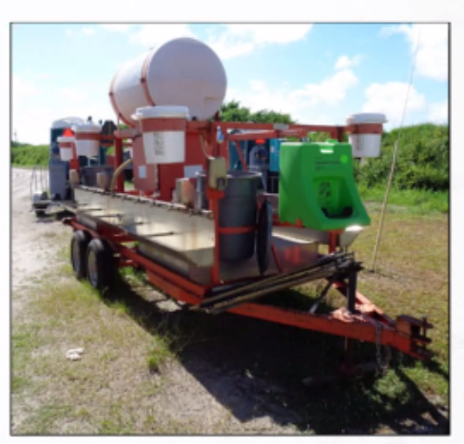
Portable Hand Washing Station

Slide 30
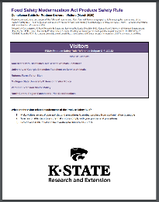
Visitors
You must make visitors aware of policies and procedures to protect produce and food contact surfaces from contamination
You must take all steps reasonably necessary to ensure that visitors comply with such policies and procedures
You must make toilet and hand-washing facilities accessible to visitors
Review the Visitor Compliance Guide
Notes:
https://www.ksre.k-state.edu/foodsafety/produce/fsma/docs/visitor.pdf

Slide 31
Equipment, Tools, & Buildings

Slide 32
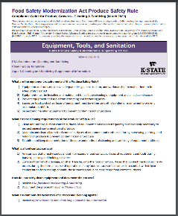
Equipment, Tools, & Buildings
Equipment, tools, and buildings must be of adequate design, construction, and workmanship. You must maintain these as reasonably necessary to protect against contamination of produce.
All produce contact surfaces must be inspected, maintained, cleaned, and when necessary and appropraite, sanitized. Proper sanitation will reduce contamination risks to produce.
Review the Equipment, Tools, and Sanitation Compliance Guide
Notes:
Subpart L – Equipment, Tools, Buildings, and Sanitation §112.121
https://www.ksre.k-state.edu/foodsafety/produce/fsma/docs/sanitizing.pdf

Slide 33
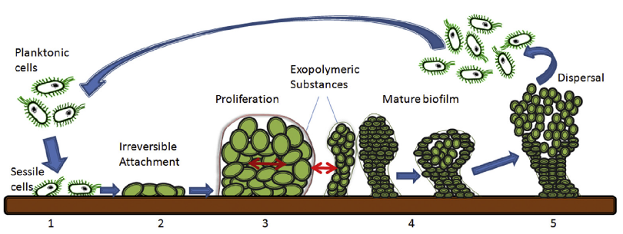
The Risk from Biofilms
Biofilms protect bacteria by anchoring a 3D complex structure onto surfaces. Biofilms can develop on practically any surface - the best line of defense is prevention of biofilms through adequate cleaning and sanitizing.
Image Credit: MFR Mizan, et al.
Notes:
1) Surface adhesion
2) Attachment process
3) Development by proliferation
4) Biofilm formation
5) Dispersal
Mizan, M. F. R., Jahid, I. K., & Ha, S. D. (2015). Microbial biofilms in seafood: A food-hygiene challenge. Food Microbiology, 49, 41–55. https://doi.org/10.1016/j.fm.2015.01.009

Slide 34
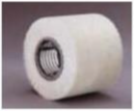
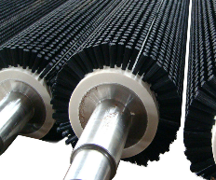
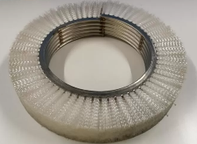
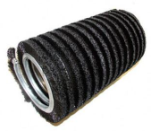
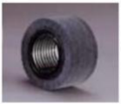
Developing an SOP
Understanding the construction of equipment is critical to understanding microbial niches and how to prioritize cleaning and sanitation efforts. There are many methods available from steam cleaning to foam detergents - work with your equipment manufacturer and chemical supplier to tailor your method.
1) What is the material of the roller and bristles?
2) What is the construction of the brush – coil, embedded, etc.?
3) What is the filth you need to clean – wax, dirt, soap, etc.?
4) Is your cleaning a wet or dry process?
5) How frequently can you clean in season?
Notes:
A special thanks to Michelle Danyluk, PhD, University of Florida IFAS

Slide 35
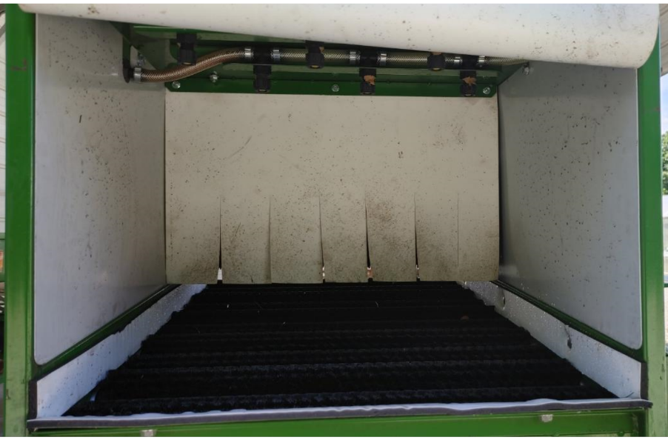
The Equipment Challenge

Slide 36
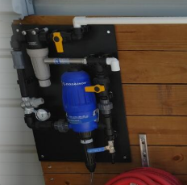
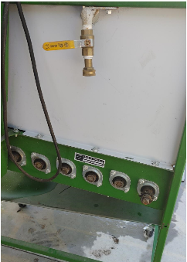
Biofilm Control
Running an injector with sanitizer into single pass washing lines will help to prevent biofilm growth, along with using established cleaning and sanitation procedures.

Slide 37
Packing Line Virtual Tour
How the equipment is manufactured determines how its cleaned. Understanding the construction is pivotal. This activity will examine a packing line.
Notes:
https://www.youtube.com/watch?v=0gXJmFBpYmQ

Slide 38
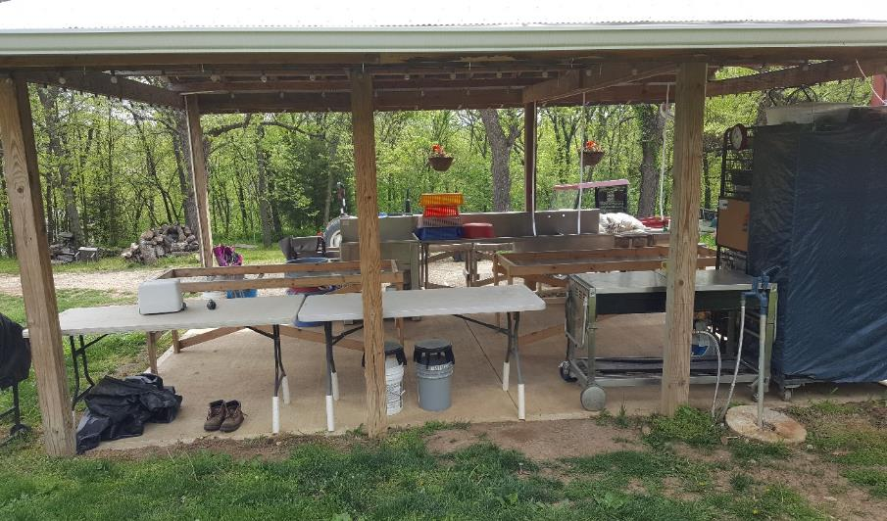
Outdoor Packinghouse
Notes:
wildlife/rodent issues
windblown contamination
flow of produce in and out
water quality and discharge

Slide 39
Developed by Cal Jamerson, K-State Research & Extension
Edits by Katelynn Stull, K-State Research & Extension
Reviewed by Londa Nwadike, PhD, Kansas State/University of Missouri Extension
This program is supported by the Food and Drug Administration (FDA) of the U.S. Department of Health and Human Services (HHS) as part of a financial assistance award U2FFD007412 totaling $380,743 with 100 percent funded by FDA/HHS. The contents are those of the author(s) and do not necessarily represent the official views of, nor an endorsement, by FDA/HHS, or the U.S. Government.
Funding for this project is made possible in part by grant 1U18FD005895-02 (KS5895) from the FDA. The information and viewpoints do not necessarily reflect the viewpoints and policies of the supporting organization, cooperating organizations, FDA, or KSU.

