Slide 1
State Food Safety Update for Farmers Markets
Prepared by Londa Nwadike
Extension Consumer Food Safety Specialist
University of Missouri/ Kansas State University

Slide 2
Outline
Updated publication (Jan 2016)
Regulations for selling at Farmers Markets
Food Safety Best Practices

Slide 3
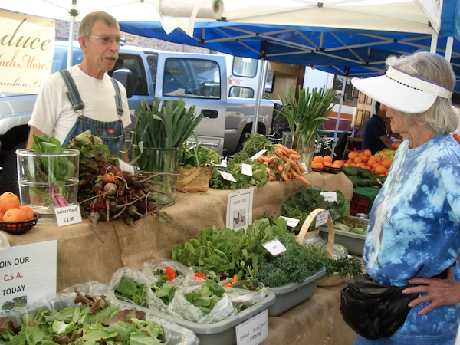
Why food safety?
Provide products as safe as possible
Assure customers that product quality and safety, and their health, is important to them
Protect markets

Slide 4
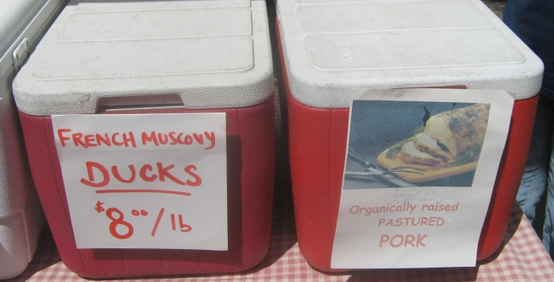
Why are there regulations?
Food borne illness outbreaks have been associated with farmers markets, local ag
No one wants to make their customers sick
Farmers/vendors should reduce their liability and protect their reputation as much as possible
Liability/ reputation of entire market also
Create a level playing field

Slide 5
KSRE/KDA regulations publication
www.ksre.ksu.edu/bookstore/Item.aspx?catId=201&pubId=17219
1- Overview: allowed foods, label requirements
5- General food safety practices, selling fresh produce, samples, demos
10- Selling prepared foods and baked goods
11- Selling meat, eggs and dairy products
14- Key contacts

Slide 6
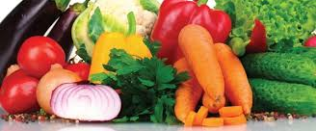
Which regulations where?
KS Dept of Ag regulates food products sales in KS
Publication covers all food sold direct to consumers
This generally includes products sold online also
Includes fairs, fundraisers, craft shows, etc. also
In KS, regulations are the same statewide
MO: regulations may vary by county, city
Sales in other states- check their regs, follow FDA/USDA regs
Individual farmers markets may have stricter requirements

Slide 7
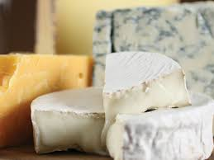
NOT allowed (WITHOUT proper licensing)
Home canned pickles, meats, vegetables, sauerkraut
Home baked cream or meringue pies, custards, cheesecakes, cream-filled cupcakes, cream cheese frostings, etc. (need temp. control for safety)
Home-made dairy products (cheese, yogurt, etc.)
Uninspected meat or poultry

Slide 8
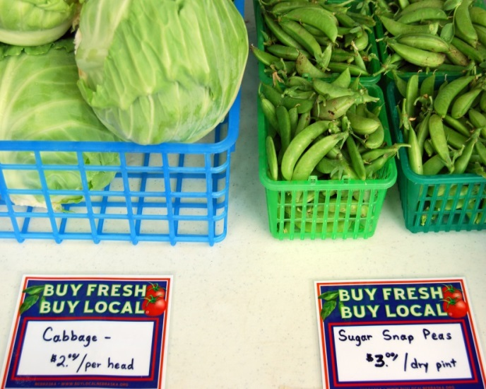
Foods allowed WITHOUT licensing (do NOT need to be labeled “homemade”- but can be)
Home baked goods (cookies, breads, cakes, etc)
Fresh or dried uncut fruits, vegetables and herbs; some cut produce, cut herbs
Intact salad greens
Dry baking mixes
Nuts (shelled or in-shell)
Honey
Eggs (food safety practices recommended, even if having <50 hens)

Slide 9
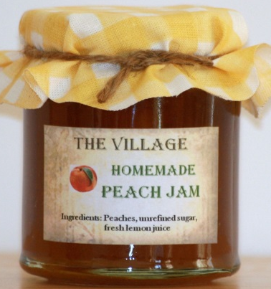
Foods allowed WITHOUT licensing- 2
Home canned fruit jams and jellies
Includes jams and jellies flavored with pepper-flavor vinegar or small amounts of pepper powder
Canned, shelf stable naturally high acid foods (canned fruits)
Pasteurized juice, cider
If not pasteurized, need warning statement, license
Home made hard candies

Slide 10
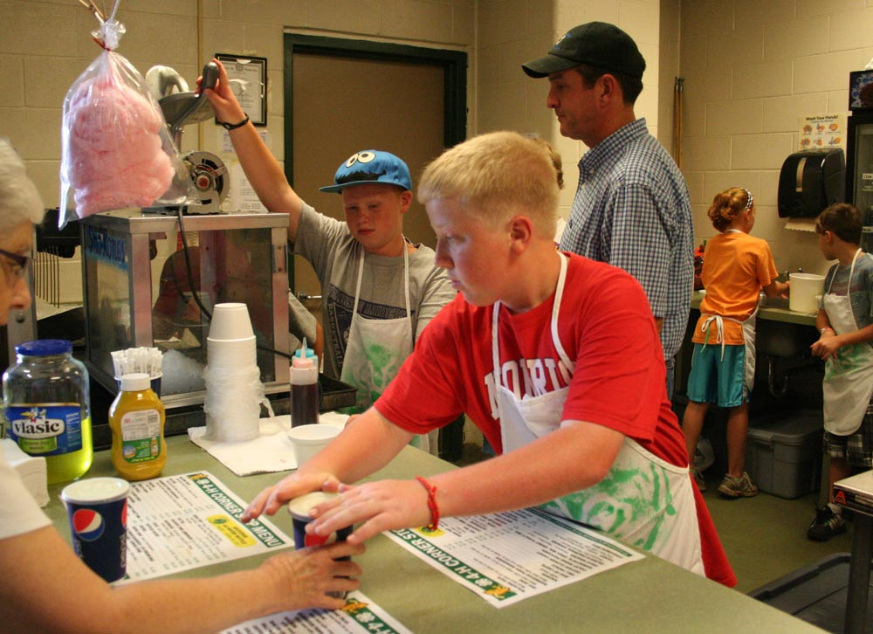
Foods allowed WITHOUT licensing- 3
Cultivated whole mushrooms (fresh or dried)
Fish and seafood- sold whole on ice
Ready to eat foods and beverages sold <6X/year
Must still follow sanitation and hygiene requirements
Ready to eat foods and drinks sold by community groups for fundraising purposes
Must still follow sanitation and hygiene requirements

Slide 11
Foods allowed WITHOUT licensing- 4
Homemade dried pasta (dry for a short time in protected environment)
Vanilla extract- follow standard of identity
Lard- no licensing if sold direct to consumer
Pepper vinegars
Grain products (flour, cornmeal, popcorn)
Fruit leathers

Slide 12
Foods allowed WITH proper licensing (regardless of number of times/year sold)
Dairy products; milk- license needed for plant and point of sale
Potentially hazardous baked products (cheesecakes, cream-filled, etc)
Raw meat and poultry
All meat must be slaughtered under inspection
Direct to consumer: does not need to be processed under inspection (required for wholesale)
Can be sold refrigerated or frozen

Slide 13
Foods allowed WITH proper licensing-2
Ready to eat meat- KDA or USDA inspected
Fish and seafood- cleaned
Sprouts- license at prod. facility and point of sale
Cut leafy greens- fresh or dried (cut beyond normal harvesting)
Cut tomatoes, melons- fresh or dried
(includes refrigerated salsa, pesto)
Wild mushrooms- class held Mar 4, 2016
Naturally fermented canned foods (sauerkraut)

Slide 14
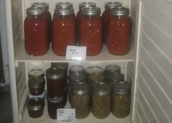
Foods allowed WITH proper licensing- 3
Acidified shelf-stable canned foods (pickles, hot sauce, canned tomatoes); low acid canned foods (canned vegetables, meats, shelf stable cake/bread in a jar)
License, recipe approval, Better Process Control School
For-profit entities selling >6 X/year: Ready to eat foods (pizza, grilled hamburgers)
Alcoholic beverages (>0.5% alcohol- beer, wine, possibly kombucha drinks)- Dept of Revenue

Slide 15
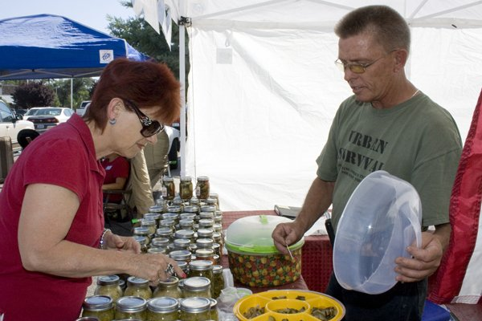
Foods that require testing first
Pepper jams and jellies- water activity
Low-sugar fruit jams and jellies (shelf-stable)- pH, water activity, product formulation
Canned, shelf-stable salsa, BBQ sauce- pH
Chocolate candies- water activity
Products can be sent to Fadi Aramouni’s lab or other accredited lab
www.ksre.ksu.edu/kvafl

Slide 16
How to get the license needed?
Visit the KDA website http://agriculture.ks.gov/divisions-programs/food-safety-lodging/food-safety-egg-lodging-app-forms
or email fsl@kda.ks.gov
or call 785 296 5600

Slide 17
What are labeling requirements?
Common name of product
Entity responsible for product (name, address)
Product ingredients (if >1 ingredient), include allergen statement
Quantity (weight, volume, count)
Note: meat products have additional requirements

Slide 18
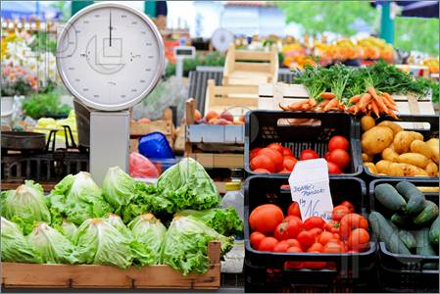
What else is needed?
Sales tax certificate- KS Dept of Revenue
Scale testing- products sold by weight must have scale tested by licensed service company once annually (KDA Weights and Measures)
Redeeming Senior Farmers Market Nutrition Program or SNAP benefits- KDHE, KDCF

Slide 19
Who enforces all this?
KDA local inspectors conduct random inspections
Extension can provide information, education
Farmers market managers should enforce any requirements specific to their market

Slide 20
General food safety practices section of publication
Regulatory requirements listed in bold & italics
Other items listed recommended for food safety
General food safety best practices
Chef demonstrations
Selling fresh produce
Includes method of retail sale for produce

Slide 21
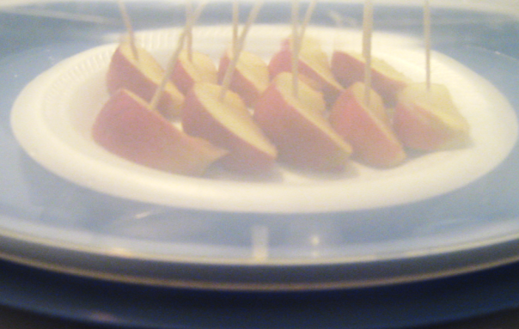
General food safety practices section-2
Selling live plants
If selling >$10,000/year live plants, license needed
Selling unique agricultural products (live birds, worms, manure, compost, etc.
Currently no state regs; check local regs
Offering product samples
No license, but need handwash and sanitizing station (later slides), pre-cut samples
Calibrating a thermometer

Slide 22
Selling prepared foods & baked goods section
Selling prepared foods
License requirements and best practices
Selling at a farmers market or a CSA
Selling baked goods
Selling jams, jellies, canned foods
Selling refrigerated/frozen processed foods

Slide 23
Selling meat, eggs, dairy products section
Selling meat and poultry products
Selling eggs
Selling dairy products

Slide 24
Other sections
References and other resources
Key contacts
Questions on?
Who to contact
Website
Email
Phone

Slide 25
Incubator kitchens in KS
No such thing as a “certified kitchen”
Every processor/producer must have own license
Unless someone is willing to take liability for you
Inspector will look at YOUR process in a facility
Can use a facility that has already been licensed
Need to meet KDA facility requirements
Can check with local restaurants, schools, fairgrounds, etc.
Jetmore, Salina, Glacial Hills (Horton)- examples

Slide 26
KS processed food requirements-1
*see KDA Daily Self-Inspection Checklist handout
May be in a private home, but separated from home kitchen
Personnel- good hygiene
Buildings and Grounds
Smooth, easily cleanable, durable floors, walls, ceilings
Safe and adequate water supply
Sanitary Facilities and Controls
Sanitary wastewater disposal

Slide 27
KS processed food requirements-2
Equipment and Utensils
Means of washing and sanitizing: 3-bin sink
Separate sink dedicated for handwashing
Processes and Controls
Refrigerated foods held at <41F
Hot foods held at >135F

Slide 28
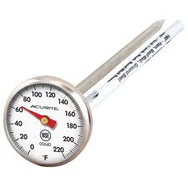
Food safety best practices
Transport, store foods at proper temps to prevent rapid bacterial growth
Hot prepared foods: >135°F (140°F better)
Foods sold at room temp (whole produce, canned goods, most baked goods): < 80°F
Cold perishable foods (potato salad, most dairy products): <41°F
Frozen foods (frozen meats) <15°F
Coolers and ice packs or ice

Slide 29
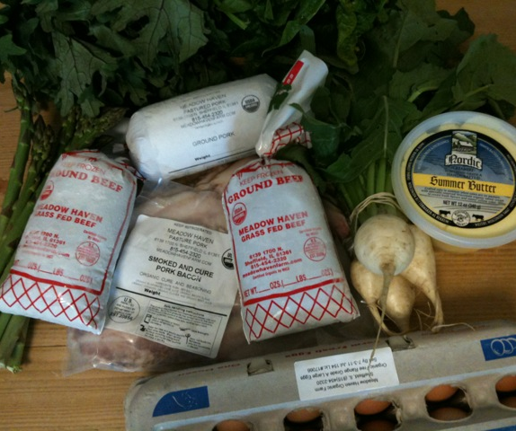
Best practices-2
Reduce possible cross-contamination: can transfer bacteria from one food to another
Ensure that raw meat does not contact ready-to-eat food or fresh produce.
If re-using bags, ensure they are clean
Wash, rinse, sanitize food contact surfaces, equipment, utensils between uses

Slide 30
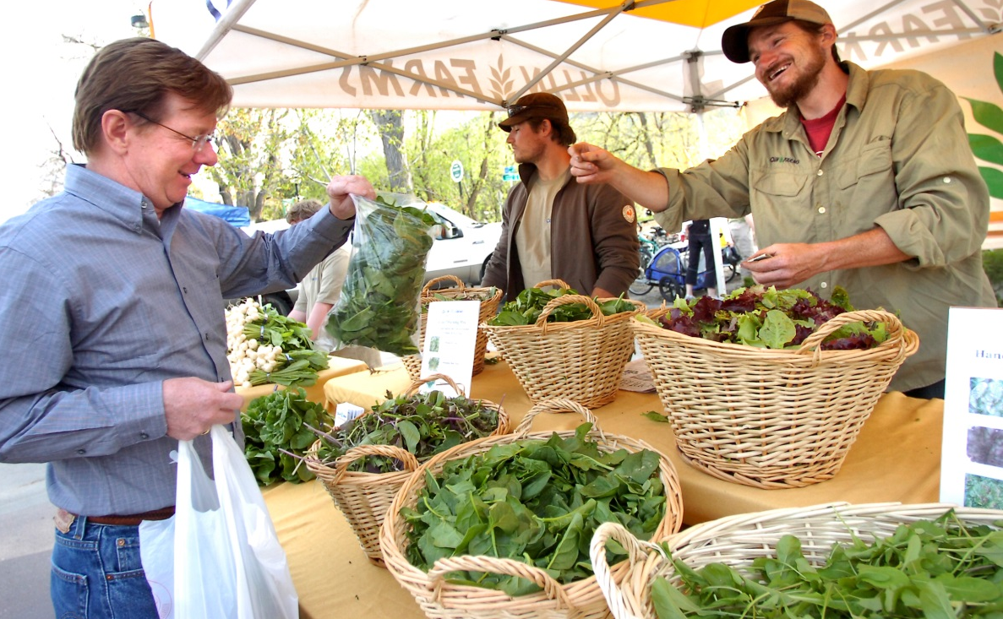
Best practices-3
Practice good personal hygiene (clean clothes, clean hands) to prevent transferring bacteria to your food
Shaking hands, touching money, animals, soiled vegetables, utensils
Wash hands often
Bare hand contact?
No eating in booth

Slide 31
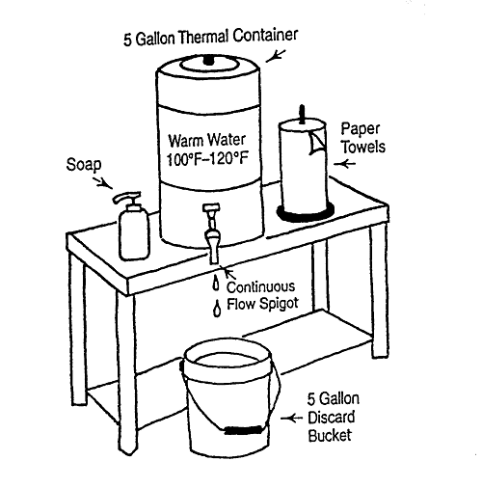
Handwashing station
Container
Tra
Trash receptacle

Slide 32
Hand wash station estimated costs
Item | Options | Where to buy | Cost
Water dispenser | 1: Insulated 10 gallon water dispenser (hands free spout) | Discount store | $46
 | 2: Insulated 5 gallon water dispenser | Discount store | $22
Bucket to catch water | 5 gallon- can be used | Second hand store | $5
Paper towel holder |  | Discount store | $2 .50
Paper towels |  | Any grocery/store | $1
Liquid hand soap |  | Any grocery/store | $1
Bin to collect trash | Any trash container | Discount store | $5

Slide 33
Washing and sanitizing station
Wash Rinse Sanitize
Soak for 30 seconds
Use potable hot water (>110 F)
Check sanitizer concentration with test kit (~50 ppm)
Allow to air dry on clean paper towels or racks

Slide 34
Washing and sanitizing station
Item | Options | Where to buy | Cost
Dishpans-3 | Buckets also OK | Discount or other | $2 each
Dishsoap | Any | Any store | $2
Dishrags | Must be clean | Any store | $1
bleach | Any brand | Any store | $1
 | *Chlorine wipes | Any store | $5/75 ct.
Chlorine test strips |  | Ag, pool, or restaurant supply | $11/200
Food handling | Disposable gloves | Discount or other | $4
 | Tongs | Discount or other | $2

Slide 35
Additional information
KS Value Added Foods Lab (KVAFL- scheduled processes, product testing, nutrition facts)
www.ksre.k-state.edu/kvafl/
Kansas Department of Ag Food Safety and Lodging
http://agriculture.ks.gov/divisions-programs/food-safety-lodging
KSU Extension Food Safety website
www.ksre.k-state.edu/foodsafety/

Slide 36
Contact Details
Londa Nwadike
Extension Consumer Food Safety Specialist
Kansas State University/ University of Missouri
Cell Phone: 913 313 9273 Email: lnwadike@ksu.edu
http://www.ksre.ksu.edu/foodsafety/

