Slide 1
The Extension Board Organizational Meeting
Board Leadership Series
Notes:
The organizational meeting provides an opportunity to review board member responsibilities and learn more about issues important to successful board function.

Slide 2
Items to Review
    Memorandum of Understanding
    Responsibilities and Duties of the Executive Board
    Guidelines for Expanding PDCs
    Kansas Open Meetings Act
    Kansas Open Records Act
    Extension Extramural Funds Policy
    GAAP Waiver Resolution
    Professional Scheduling Policy
    Suggested Calendar for Routine Agenda Items
Notes:
Items to be reviewed.

Slide 3
Kansas Extension Law
The Kansas County Extension Council Law first passed in 1951.
Allows for extension councils to organize for the purpose of giving instruction in:
  agriculture
  marketing
  family and consumer sciences
  4-H youth development
  community and resource development
  economic development initiatives
  (See Handbook for County Extension Councils and District Governing Bodies)
Notes:
Kansas Cooperative Extension law was first passed in 1951. The most recent significant amendment, passed in 1991, established a process to create extension districts. The purpose of the extension council is to conduct educational programs in specific program areas.

Slide 4
Kansas Extension Law--Programs
Program development committees study community needs and recommend priority programs.
Expanded membership (non-voting)-for representation that might not already be on the PDC.
The extension board and the Director of Extension’s Representative approve the action plans that are to be implemented by extension agents.
Notes:
Program development committees (PDCs) are specified in the law. They recommend and identify issues and priorities.

Slide 5
Kansas Extension Law--Agents
Extension Agents are jointly hired and are responsible to the local Board and Kansas State University.
The University contributes salary and benefit dollars for each agent.
The Board and the Director of Extension’s Representative annually evaluate the performance of the agents
Notes:
The law allows extension boards to hire agents and to conduct educational programs in partnership with Kansas State University. Agents are responsible to the board and the university.

Slide 6
Kansas Extension Law--Budget
Annual budget is adopted in the spring and early summer by extension board and extension director’s representative.
Proposed extension council budget for an independent county is submitted to county commissioners by July 15 for funding. Commission does occasionally request earlier.
District governing bodies must develop, approve and file budgets by August 25. Publication and public hearings are required.
Adjustments are made as necessary and an annual budget is determined for the following calendar year.
Notes:
The board develops an annual budget in conjunction with a representative of the director. Extension council budgets must be submitted to the local county commission by July 15 for consideration and approval. District Governing Bodies must develop, approve and file budgets by August 25.

Slide 7
Kansas Extension Law--Expenditures
All accounts and all expenditures of funds of the local extension unit, from whatever source derived, are subject to the approval of:
  The extension board or governing body
  The Director of Extension, Kansas State University
Notes:
The director of K-State Research and Extension is responsible for all expenditures, so policies guide budget management and operation. The board must approve all local expenditures.

Slide 8
Kansas Extension Law--Districts
The Extension District Law was passed in 1991. The law allows two or more extension councils to form an extension district or allows an independent county join an existing district.
Primary objectives for districting include improved efficiency, effectiveness, and sustainability.
Each extension district is a taxing subdivision of the State of Kansas.
Notes:
Since the extension district law passed in 1991, many extension councils have formed extension districts. More councils are discussing the possibility of improving efficiency, effectiveness and sustainability by forming districts.

Slide 9
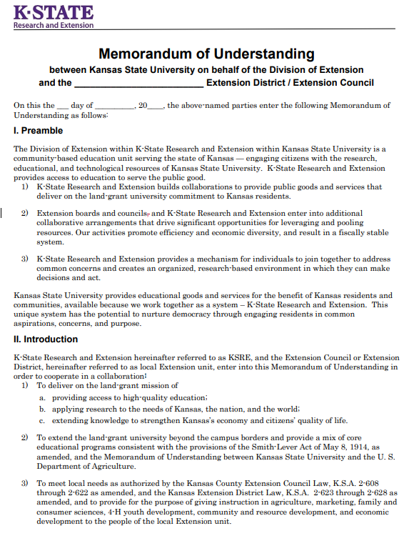
Memorandum of Understanding
This document outlines the division of responsibilities between K-State Research and Extension and the local extension unit.
(See Handbook for County Extension Councils and District Governing Bodies)
Notes:
(Provide Memorandum of Understanding handout.) The Division of Extension at Kansas State University and local extension boards have developed a memorandum of understanding that outlines the cooperative working relationships of each partner in developing and conducting local educational programs; employing extension agents; and approving budgets, accounts and expenditures.

Slide 10
Extension Board Member Position Description
Board Member Expectations:
Work in partnership with KSRE and the local unit director to transact the business of the local extension program.
Participate fully in regularly scheduled board meetings in order to carry out the duties of the board.
Volunteer to serve on board committees and/or as an officer.
Read and review the KSRE Board Excellence Newsletter.
Work with the local unit director to develop a budget for the council/district and participate in public hearings and presentations of the budget.
Review monthly financial operations of the local unit.
Become familiar with each agent and their programs.
Notes:
Provide extension board member position description.

Slide 11
Extension Board Member Position Description
Board Member Expectations:
Attend extension sponsored educational events.
Review and approve agents’ action plans.
Participate in agent performance review process by completing performance documents for each agent.
Market extension programs to the public and advocate for support of local programs.
Complete annual civil rights training and help ensure the local extension program makes all reasonable efforts to reach all audiences.
Review modules on the Board Leadership website and the duties of the board to better understand a board member’s role.
Participate in the KSRE meeting opportunities.
Provide input into the Excellence in Board Leadership Summary.

Slide 12
Equal Access
K-State Research and Extension is an equal opportunity provider and employer.
We have a federal requirement and moral obligation to ensure that all extension programs are available and accessible to everyone. We monitor this through:
Annual civil rights reporting
Annual board training
4-year comprehensive local unit reviews
Federal civil rights reviews—period or complaint generated
Notes:
As an organization receiving federal, state and local tax dollars, K-State Research and Extension is committed to providing equal access to educational programming and employment for all residents. There are a number of steps each office is to take to work toward this goal.

Slide 13
Kansas Open Meetings Act
Conduct affairs and transact business in meetings which are open to the public.
Refrain from taking any binding action by secret ballot.
Provide notice of the date, time and place of any regular or special meetings to anyone requesting such notice.
Make the agenda for any meeting available to anyone requesting it.
Notes:
(Provide Kansas Open Meetings Act handout.) Public boards in Kansas are required to follow the provisions of the Open Meetings Act. Meetings must be open to the public. Boards must provide advance notice of board and PDC meeting locations and times when requested. (Review the handout.)

Slide 14
Public Participation in Meetings
The right of the public to view the workings of the Extension Council/Executive Board should not be confused with a right to speak at the board meetings.
Visitors do not have the right to express their views or participate in the board meetings. The board/governing body policy may grant this right.
Notes:
The public must be allowed to attend board meetings, but they are not entitled to speak or otherwise participate. Boards may develop a policy to set aside time for public comment.

Slide 15
Executive Sessions
Recess into Executive Session only for those reasons stated in the statute, which are:
Personnel matters of non-elected personnel
Consultation with an attorney which would be deemed privileged in attorney-client relationships
Matters relating to employer-employee negotiations
Preliminary discussion relating to the acquisition of real property (districts only)
Matters relating to actions adversely or favorably affecting a person as a student, patient, or resident of a public institution
Confidential data relating to financial affairs or trade secrets of corporations, partnerships, trusts and individual proprietorships.
Notes:
Boards may recess into executive session for limited reasons. Extension boards typically do so to discuss employee or volunteer personnel matters, including evaluations, salary, or other instances where it is necessary to protect the privacy of the individuals being discussed.

Slide 16
Executive Sessions
The motion for recessing into executive session must contain the following information:
The justification for Executive Session.
The time and place at which the open meeting will resume.
Any individual(s) invited to participate in the Executive Session.
Discussion shall be limited to subject stated in motion.
No binding action shall be taken during Executive Session.
Notes:
The motion to go into executive session must give the reason for the session (i.e., to discuss employee evaluations), the time and place the meeting will resume, and the names of any individual(s) to be invited to participate with the board. Nothing else may be discussed, and no action may be taken until the board resumes regular session.

Slide 17
Kansas Open Records Act
KSRE subject to KORA
KORA specifies process and exemptions
Direct requests to designated records custodian at KSU by contacting the regional director
Notes:
Local offices of K-State Research and Extension are subject to the Kansas Open Records Act. The KORA states that “public records should be open for inspection by any person.” The law also specifies a process for the public to use in requesting records as well as a list of records that are exempt. Open records requests for any office affiliated with Kansas State University should be directed to the Designated Records Custodian in the Division of Communications and Marketing at Kansas State University.

Slide 18
Grant Policy and Approval Process
An Extramural Funds Approval Form must be reviewed and approved by the extension board and the regional director prior to submission of any grant proposal being submitted.
If any of the questions on the form are answered “No”, then the proposal must be processed through the University and cannot be administered by the local unit. On occasion, the funds may be managed by a non-profit local partner with the capability of handing the funding.
Notes:
(Provide Extension Extramural Funds Policy handout.) K-State Research and Extension policy requires the board and the regional director to review and approve grant proposals before they can be submitted and administered by the local board.

Slide 19
GAAP Waiver Procedures
Kansas law requires municipalities to use generally accepted accounting principles (GAAP) in the preparation of their financial statements and reports.
Extension boards, using cash basis and budget laws, may waive this statutory GAAP requirement by adopting a GAAP Waiver Resolution.
Notes:
(Provide GAAP Waiver handout.) Kansas law requires local units of government to use generally accepted accounting principles (GAAP). However, extension councils and districts use the cash basis of accounting. The law allows the board to adopt a resolution waiving GAAP requirement.

Slide 20
Office and Personnel Policy
Each local unit should develop an office and personnel policy document.
The policy should be reviewed annually and updated, as necessary.
Notes:
Extension boards should adopt office and personnel policies to direct office operations.

Slide 21
Knowing Your Agents
    Agent and Office Staff Job Descriptions
    Agent Professional Development Plans
    Agent Action Plans
    Local Unit Extension Director Policy and Position Description
Notes:
(Provide copies of agent job descriptions, agent professional development plans, agent action plans, and the local unit extension director job description.) Board members should get to know each agent, understand the scope of the job and the action plan the board has approved for the agent.

Slide 22
Professional Scheduling Policy
Achieve responsibilities of the position
Achieve balance of professional and personal time
Notes:
(Provide Professional Scheduling policy.) Professional scheduling is defined as the responsibility of arranging one’s work schedule to best achieve the responsibilities of the position and meet the needs of constituents, while achieving a balance of professional and personal time that is productive and healthy for the organization and the individual.

Slide 23
Board Organizational Meeting Action Items
Designate a bank for extension funds
Adopt GAAP Waiver Resolution for calendar year
Adopt holiday schedule (state, county, other)
Review annual budget and make necessary adjustments
Authorize electronic funds transfers and direct deposit of employee pay (if applicable)
Set regular meeting dates and times
Review item: Memorandum of Understanding, Open Meetings Law, EEO policy, Extension related statutes
Notes:
Action items for the Organizational Board Meeting include designating a bank for extension funds, considering the adoption of a GAAP Waiver Resolution and adopting a holiday schedule for the year. The board can adopt the state holiday schedule or another appropriate schedule, such as the county schedule (particularly if housed in a county building). The state discretionary day is granted only if the state holiday schedule is adopted. The annual budget should be reviewed.
The board will need to establish regular meeting dates and times. (Provide a copy of the handout Suggested Calendar for Routine Agenda Items.)
All board members are encouraged to participate in Partnership Meetings, which are held throughout the year via ZOOM. Board members will be notified of dates of upcoming meetings.

