Slide 1
Babysitting Training Curriculum for Adolescents in Your Communities
Bradford Wiles, Elizabeth Kiss, Elaine Johannes, and Nora Rhoades
FCS August Update - Manhattan, Kansas
August 28, 2018

Slide 2
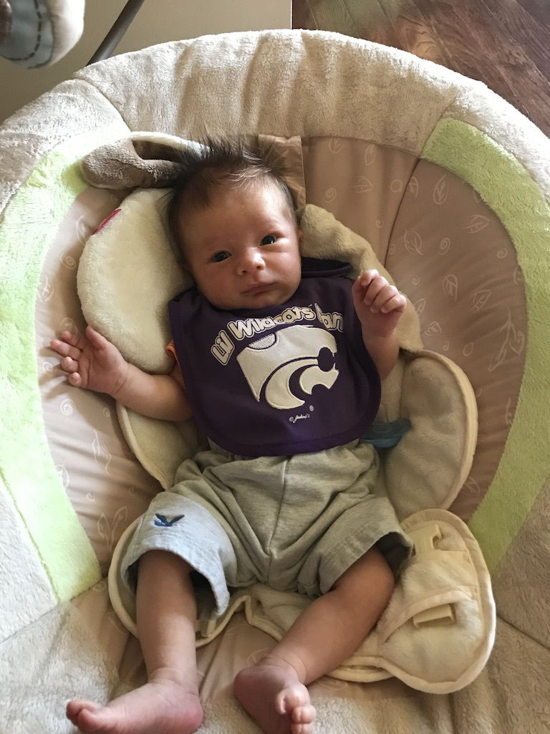
For Our Purposes “Babysitting” means:
Care for a child temporarily, while primary caregivers are not home
  Event-based care (e.g. date night, grocery shopping, respite care, elder care)
  Usually takes place in the child’s home
Not “child care” (i.e. regular, professional, licensed care)
Usually care provided by adolescents as a service

Slide 3
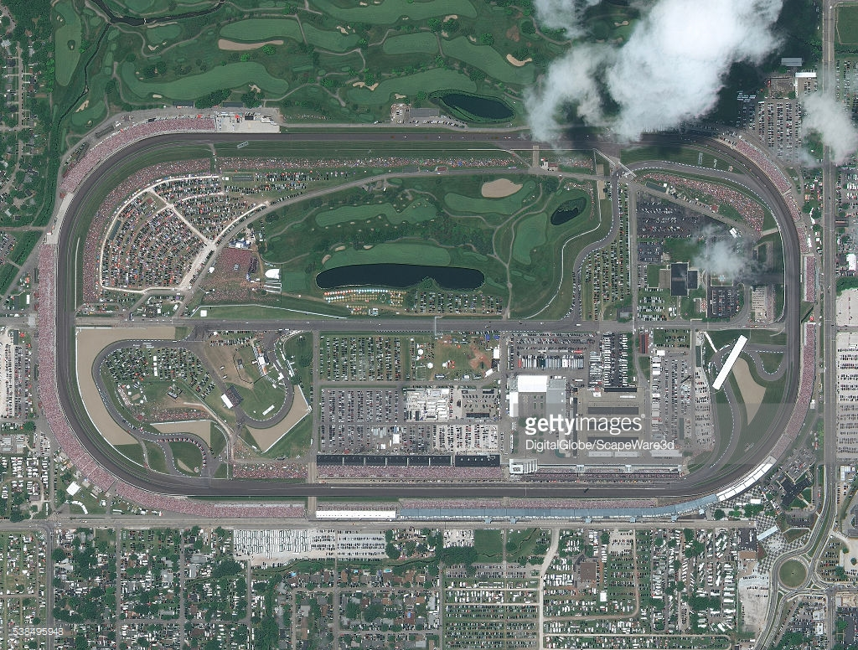
Overview
Overview of Babysitting Curriculum
  Where we have been
  Where we are
  Where we are going
  Integration of Babysitting across Program Focus Areas
  Resource overview with Nora Rhoades, Elaine Johannes, Elizabeth Kiss, and Bradford Wiles
  Family Resource Management perspective with Elizabeth Kiss
  Positive Youth Development perspective with Elaine Johannes
  Child health and development perspective with Bradford Wiles
Upcoming resources

Slide 4
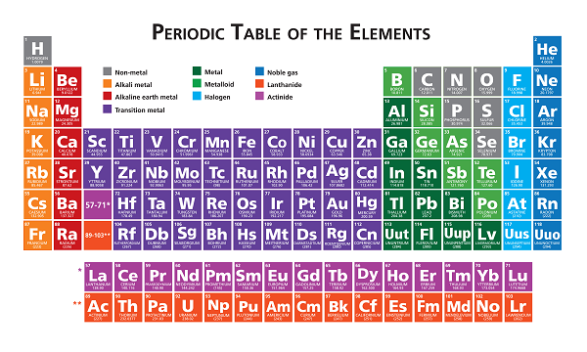
Important Elements
Guidelines for when to leave a child home alone
  Generally 10 and above
  Multiple considerations
We do NOT CERTIFY participants
  Do not use attendees as a referral list
  Legal liabilities could be present
  Kansas does not certify “babysitters”

Slide 5
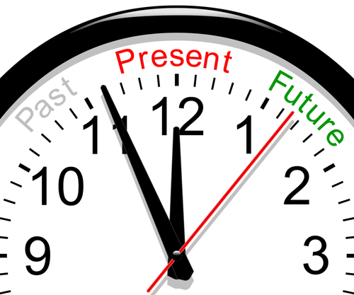
Babysitting Past, Present, Future
4-H Military Partnership history
Adaptation of 4-H Military Partnership materials
Call for fidelity and updated materials
Dr. VerBrugge’s discussions with Military Partnership
American Red Cross training resources
4-H Military Partnership curriculum 2.0

Slide 6
Overview of American Red Cross Resources
Available here
Seven content chapters
  Leadership (Elaine Johannes)
  Business (Elizabeth Kiss)
  Safety – (Nora Rhoades)
  Child Development (Bradford Wiles)
  Feeding and Bedtime (Bradford Wiles)
  Emergency procedures (Nora Rhoades)
  First Aid, CPR, and AED - Automated External Defibrillator (Nora Rhoades)
Notes:
AEDs are portable electronic devices that can deliver a defi brillation shock to help the heart restore an effective (pumping) rhythm. Certain AEDs with pediatric AED pads can deliver lower levels of energy considered appropriate to a child or an infant under age 8 or less than 55 pounds. An AED can deliver that shock, either automatically or with the push of a button.
is a small, lightweight device that analyses a person's heart rhythm and can recognise irregular heart rhythms such as ventricular fibrillation (VF) or ventricular tachycardia (VT), also known as Sudden Cardiac Arrest.

Slide 7
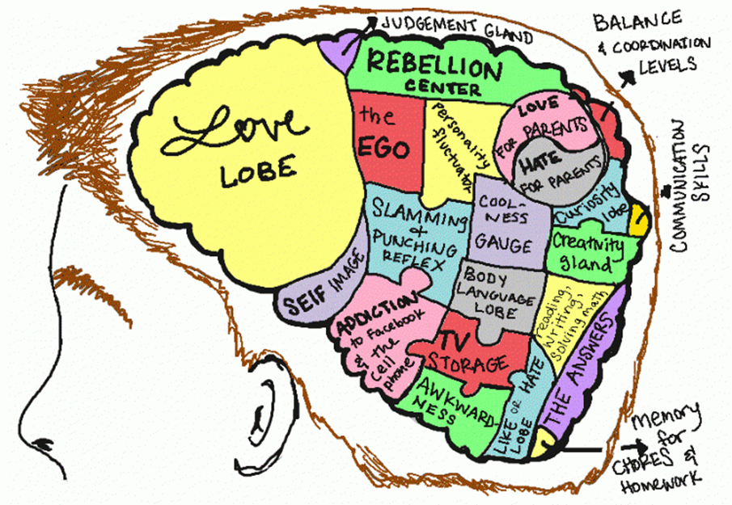
Adolescent Development & “Leadership” (Chapter 1)
Cognitive & Identity development
KSDE Career Clusters, Pathways and Individual Plans of Study (IPS)
“Risks and rewards" for teens
CHAPTER 1
Respect and Household rules
Diversity
Communication
Decision Making

Slide 8


Personal Finance and The Business of Babysitting (Chapter 2)
Earning Power: More than a Paycheck
Money Management: Control Your Cash Flow
Financial Services: Care for Your Cash
CHAPTER 2
Getting Started
Finding Work
Interviewing the Family
Professional Behavior

Slide 9



Safe and Sound on the Job (Chapter 3)
Strategies to Play it Safe
It’s an Emergency… Now What? (Chapter 6)
What Is an Emergency?
  Understanding Risks: Weather, Fire, Violence, First Aid, etc.
  In an Emergency: CHECK / CALL / CARE
First Aid, CPR and AED (Chapter 7)
Skill Building for Emergency Response
Notes:
SAFE AND SOUND ON THE JOB:
KNOWLEDGE GAIN
RISK AUDIT while taking a walk
ROLE PLAYING
Prevent the Safety-Related Problem
Recognize the Safety-Related Problem
Fix the Safety-Related Problem
Telephone Safety Tips
Personal Safety
Danger from Strangers
Other Safety Considerations
Rural Safety
Safety Inspection Checklist
Preventing Accidents and Injuries
Choking and Breathing Dangers
Drowning
Falls
Fire
Illnesses
Riding Toy/Vehicle Injuries
Parks and Outdoors
Safe Fun in the Sun
IT’S AN EMERGENCY and FIRST AID:
Check // Call // Care Knowledge
Different Emergency Knowledge
Transparency with Parents about Skill Level
Practicing skills – opportunity to partner with EMS or Health Department
**Beginner Level, maybe explore advanced level (advanced could include certification, but would carry additional costs)

Slide 10

Understanding Kids From 0 To 10
Ages, Stages, and Milestones
Children and Play
  Why is Play Important for Children?
  How Do Children Play?
  Why Should You Play with Children?
Helping Children Behave
  Encouraging Positive Behavior
  Correcting the Behavior Without Criticizing the Child
  Consequences
  Common Behavior Challenges (Tantrums; Crying; Breath-holding; Colic; Biting, Hitting, and Kicking; Sibling Rivalry)
NEVER SHAKE ANOTHER LIVING BEING!!!

Slide 11

From Feeding to Bedtime: Caring for Kids
Talking to the Parents About Basic Child Care
Picking Up and Holding Children
Feeding Children
Diapering
Dressing Children
Bathing Toddlers
Rest and Sleep
Sudden Infant Death Syndrome (SIDS)
Notes:
https://www.panmacmillan.com/blogs/books-for-children/bedtime-stories-for-kids

Slide 12
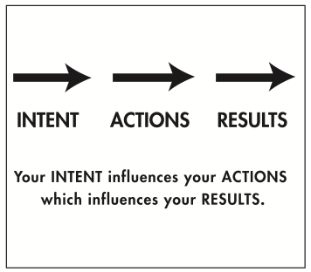
Intent for American Red Cross resource
Replace any piecemeal version of old 4-H Military Partnership efforts (go legit!)
Provide resources to your community on an as-needed basis
To familiarize FCS Agents with resource
To serve as an intermediate step to the revised Revised 4-H Military Partnership curriculum

Slide 13
Switching Gears to Integration:
Child Development
Adolescent Development
Family Resource Management
Babysitting in Communities
Babysitting in the context of Positive Youth Development (PYD); risks & rewards
Babysitting in the context of the KSDE Career Cluster Pathways
Babysitting and 4-H career and college interests
Notes:
Adolescent Development
Family Resource Management
Child Development

Slide 14

Upcoming Resources
Revised 4-H Military Partnership curriculum in Spring of 2019
Evaluation and Big “P” Program roll out

Slide 15

Acknowledgements
Marlene VerBrugge and the 4-H Military Partnership Team
KSRE FCS

