Slide 1
Volunteer Quantity Cooking Safety
Londa Nwadike
Extension Consumer Food Safety Specialist
University of Missouri/ Kansas State University

Slide 2
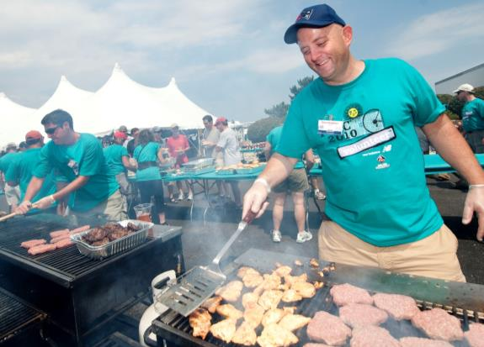
Presentation outline
Why is this topic important?
Key food safety practices
  Planning
  Personnel
  Shopping
  Storing
  Preparing food
  Cleaning up
www.pmc.org

Slide 3
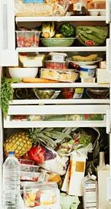
Why is Food Safety Important for Volunteer Quantity Cooks?
Food- builds community, money maker
  Fundraising dinners, concession stands, community meals, family reunions, funeral meals, etc.
Volunteer cooks, few regulations
Large quantities different than small
  Need proper equipment

Slide 4
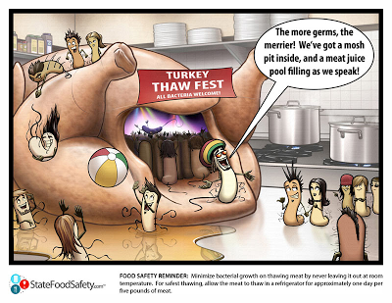
Why is this important? -2
Foodborne illnesses have occurred
  179 got C perfringens- turkey dinner in KS, 2010
Tarnished reputation, legal repercussions

Slide 5
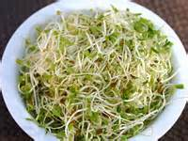
Planning
Check if licensing is needed
  KS: not needed if sold for fundraising purposes
Do NOT serve high risk food
  Raw or undercooked foods
Ensure that equipment and trained personnel are available

Slide 6
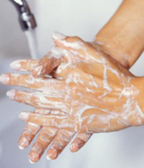
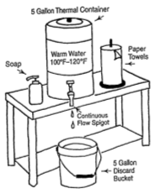
Personnel
Wash hands!
  Portable handwashing station info on p 4
Clean clothing and hair restraints
Don’t work if you have an infection, cold
Bandage cuts, disposable glove over
Never smoke, eat, drink in food preparation area
Don’t use cooking utensil to taste food

Slide 7
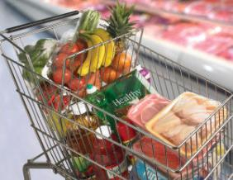
Shopping
Acquire from safe sources- buy or homegrown
Separate meat from RTE foods in cart and bags
Ensure that perishable foods are not in TDZ (40-140F) for >2 hours; 1 hour if > 90F outside
  Bring coolers/ ice if needed

Slide 8
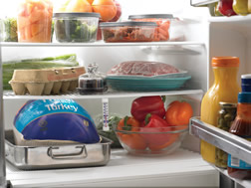

Storing
Ensure enough clean (refrigerated) storage space
  Don’t overfill refrigerator
Use refrigerator thermometer (<40F)
From bottom to top: poultry, ground meat, RTE
Use freezer thermometer, ensure door closes
Store non-perishables on an (easily cleanable) rack
Use only food grade containers for storing

Slide 9
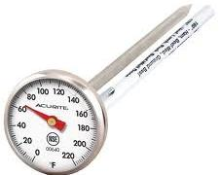
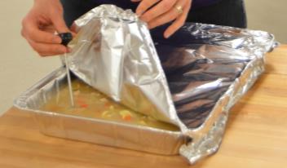
Preparing food
Cook: use a thermometer!
  Temperature table on p4
    Temperature (NOT color!) kills bacteria
Chill: thaw meat properly
  Ensure that product gets to <40F 4 hours after cooking
    Ice bath, stir, and/or smaller quantities
Separate: Different equipment for raw and RTE

Slide 10
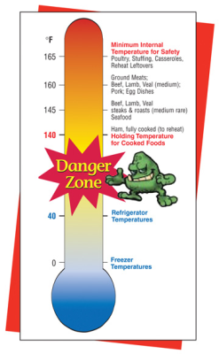
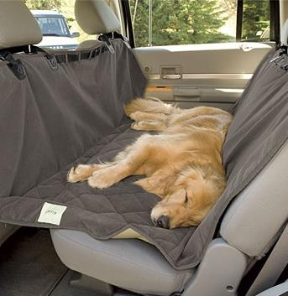
Transporting
Do not allow perishables at 40-140F for > 2 hrs
Transport in clean vehicles, cover to protect

Slide 11
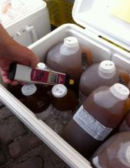
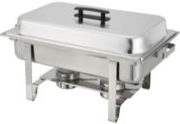
Serving food
If reheating, 165F within 2 hours (microwave, stovetop, oven)
Hold hot foods (covered) >140F. Check temp!
Hold cold foods at <40F.
Even if wearing gloves, still need to wash hands
No bare-hand contact with RTE foods
New plate every time guests go to buffet

Slide 12

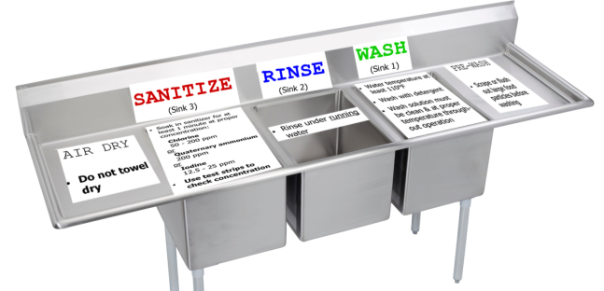
Cleaning up
Wash and sanitize countertops
  Make sanitizer every 3-4 hours
    1 tsp bleach to 1 gallon water
If commercial dishwasher not available, 3 sinks
  clean sink first
  Sanitize- could also use hot water (>170F) for 30 sec
www.haverford.edu

Slide 13
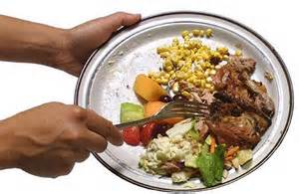
Leftovers
Do NOT reuse foods that have been served
  (Put out on a buffet or put on a plate at a table)
Foods prepared but not served can be reused
  Must have been held at proper temp, cooled properly
Reuse prepared but not served food within 1-2 days

Slide 14
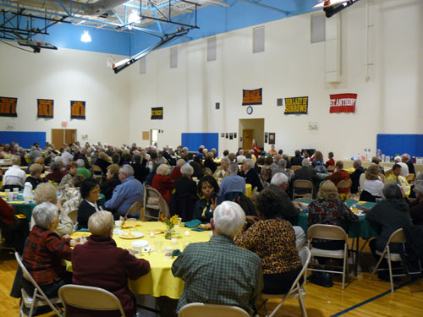
Next steps
Develop a list of the top items to work on before preparing a larger than normal meal
mealsonwheelsofwesternbroome.com

Slide 15
Additional information
Volunteer Quantity Cooking Safety Fact Sheet
  www.bookstore.ksre.ksu.edu/pubs/MF3213.pdf
KSRE Safe Food Preparation webpage:
  www.k-state.edu/foodsafety/topics/preparation.html
Food Safety.gov
  www.foodsafety.gov/keep/events/parties

Slide 16
Questions?
Thank you
for your attention!

Slide 17
Contact Details
Londa Nwadike
Extension Consumer Food Safety Specialist
Kansas State University/ University of Missouri
Phone: 913 307 7391
Email: lnwadike@ksu.edu
www.ksre.ksu.edu/foodsafety/

