Slide 1
Communication Tools to Help Consumers Reduce Food Waste
2018 KSRE Annual Conference
Barb Goode
Notes:
Mission: promote sustainability through environmental education and services to industry, institutions and communities. These services include environmental compliance and pollution prevention technical assistance.
100% grant funded – so funding dictates our work.

Slide 2
Overview
Why focus on food waste?
EPA food recovery hierarchy
EPA community tool - Food: Too Good to Waste

Slide 3
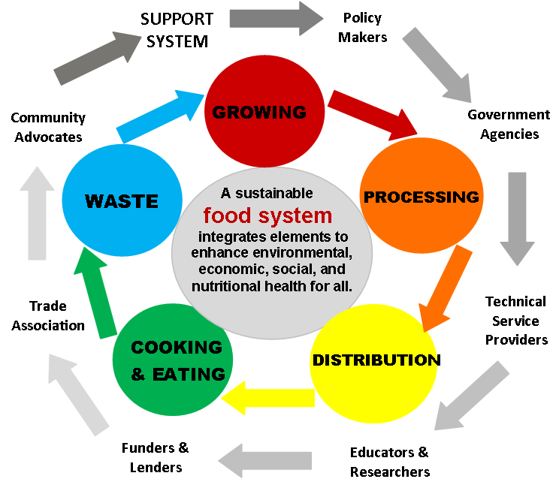
Food production and resource use
Food and agriculture consume
16% of U.S. energy,
50% of U.S. land, and
67% of all freshwater used in the U.S.
Yet, 40% of food goes uneaten!
Source: NRDC, WASTED: HOW AMERICA IS LOSING UP TO 40 PERCENT OF ITS FOOD FROM FARM TO FORK TO LANDFILL, 2017
www.nrdc.org
Notes:
We need to make our food system more efficient and less wasteful. Even with the most sustainable practices, our food system uses enormous resources.
Getting food from the farm to your plate uses 16 percent of U.S. energy, 50 percent of U.S. land, and 67 percent of all freshwater consumed in the U.S. (From NRDC 2017 report)
Yet 40 percent goes uneaten!

Slide 4
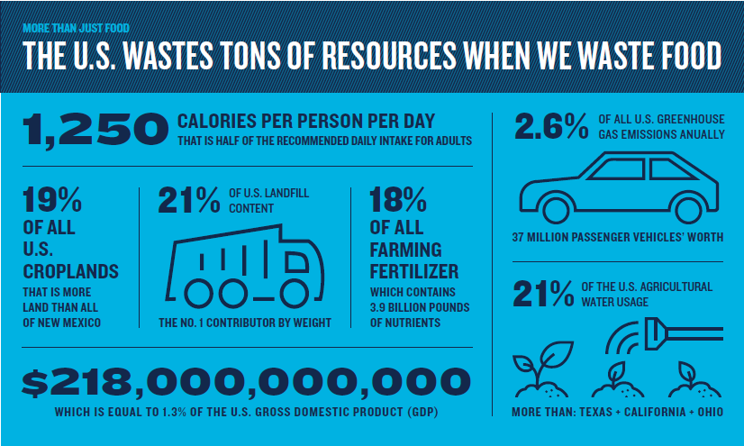
Source: NRDC, WASTED: HOW AMERICA IS LOSING UP TO 40 PERCENT OF ITS FOOD FROM FARM TO FORK TO LANDFILL, 2017
www.nrdc.org
Notes:
This graphic (Natural Resources Defense Council) shows some equivalents to that 40% of food that we in the US do not eat
In one year, wasted food generates 2.6% of all the US GHG emissions. This is the GHG emissions that 37 million vehicles generate (1 in 7 cars on the road). The majority of those greenhouse gases are released by growing the food, while a portion is released as methane as food decays in landfills

Slide 5
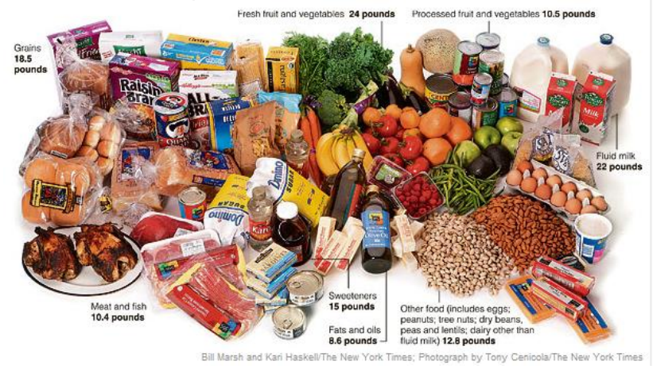
U.S. Annual Household Food Waste
76 billion pounds =
238 pounds food/person =
$450/person =
$1,800/yr for a household of four
One month waste for family of 4
Source: ReFED A Roadmap to Reduce US Food Waste by 20 Percent, (2016) www.refed.com.
Notes:
Households are responsible for the largest portion of all food waste (followed by restaurants/food service institutions, then farms and supermarkets). Throwing food away at the consumer level has a larger resource footprint than at any other point of the food chain. It has undergone more transport, storage, and often cooking,
ReFED (Rethink Food Waste Through Economics and Data) estimates U.S. household food waste totals 76 billion pounds, or 238 pounds of food per person annually. This costs $450 per person, or $1,800 per year for a household of four. [The USDA estimates that 21 percent of the total food supply is lost at the consumer level, amounting to 90 billion pounds. However, the agency’s definition includes both households and “out of home” consumption (e.g., in restaurants).]

Slide 6
EPA Food Recovery Hierarchy
Notes:
We will look at food waste reduction opportunities

Slide 7
Managing excess food
REDUCE
In 2015 – USDA and EPA joint goal to reduce food waste by 50 percent by 2030
REUSE
RECYCLE
https://www.epa.gov/sustainable-management-food/food-recovery-hierarchy
Notes:
EPA established the Food Recovery Hierarchy to help guide priorities for managing excess food. And as we’ve seen already, we have a lot of surplus food that goes uneaten—lots of opportunities to reduce food loss and waste.
The EPA Food recovery hierarchy looks at not only environmental benefits, but also financial and social benefits in its establishment of the hierarchy or priorities as to how to manage food waste.
This hierarchy has a similar approach to the reduce—reuse--recycle philosophy to solid waste; could say instead…prevent food waste (reduce), divert surplus food (reuse), compost food scraps (recycle)
Note USDA and EPA joint goal

Slide 8
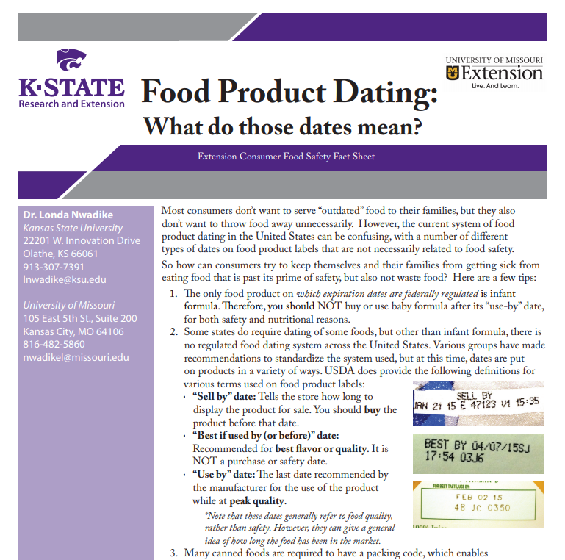
Source Reduction
Barrier to preventing wasted food is lack of standardized food date labels
Sell by
Best by
Use by
Notes:
Source reduction can also be thought of as prevention. Our program, PPI, focuses on this level of the hierarchy. It is the most effective action for addressing food loss and waste, not only environmentally, but financially. You’re not spending money and environmental resources to produce food that doesn’t get eaten.
Side note on food date labels – guidelines, manufactured designated quality date, not food safety date

Slide 9
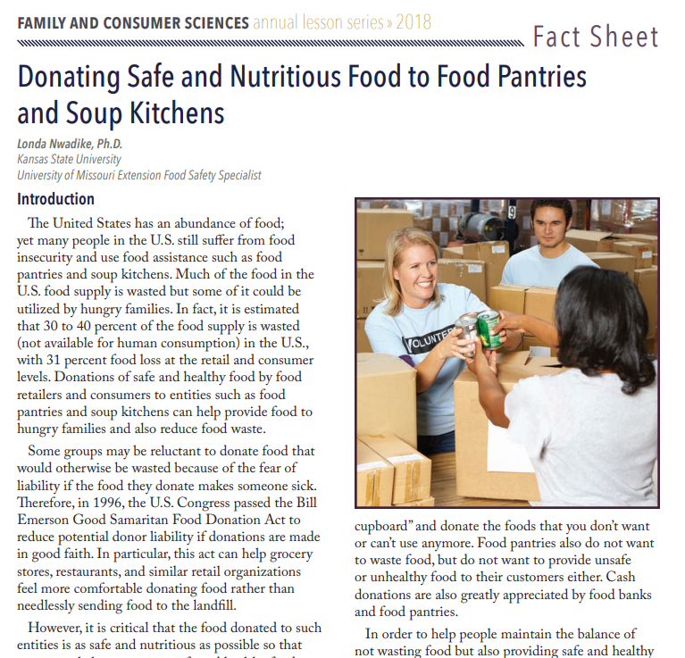
Feed Hungry People
Up to 40% food in US is never eaten
1 in 8 Americans (42 million) struggles to put enough food on the table
Donate surplus food to—
Food banks
Shelters
Soup kitchens
Barriers
Transportation
“Liability”
Notes:
One of the ironies of today’s food system is that enormous amounts of food are wasted at the same time that more than 42 million people in the United States lack a secure supply of food to their tables (food insecurity).
The United States has excellent liability protection and tax benefit laws to encourage food donation.

Slide 10
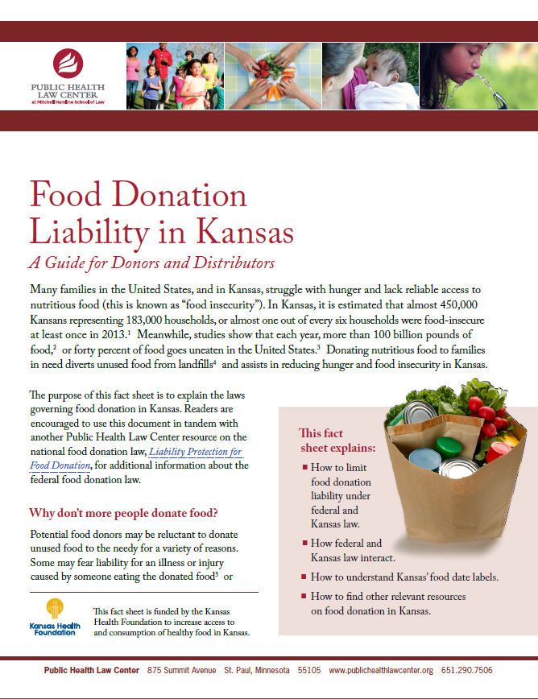
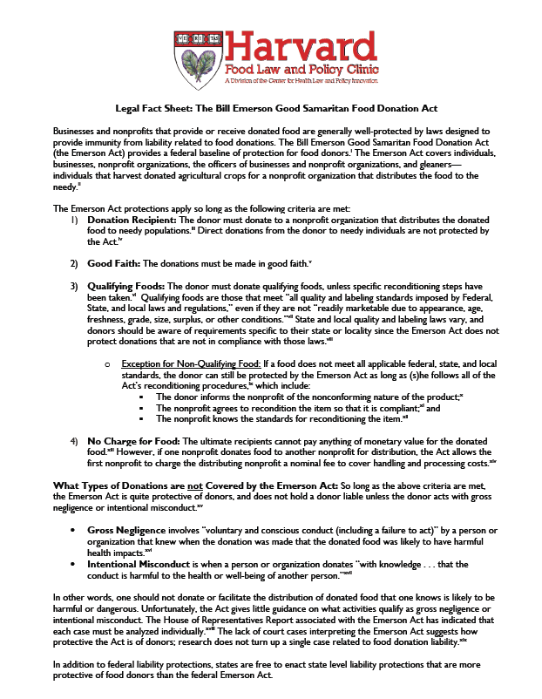
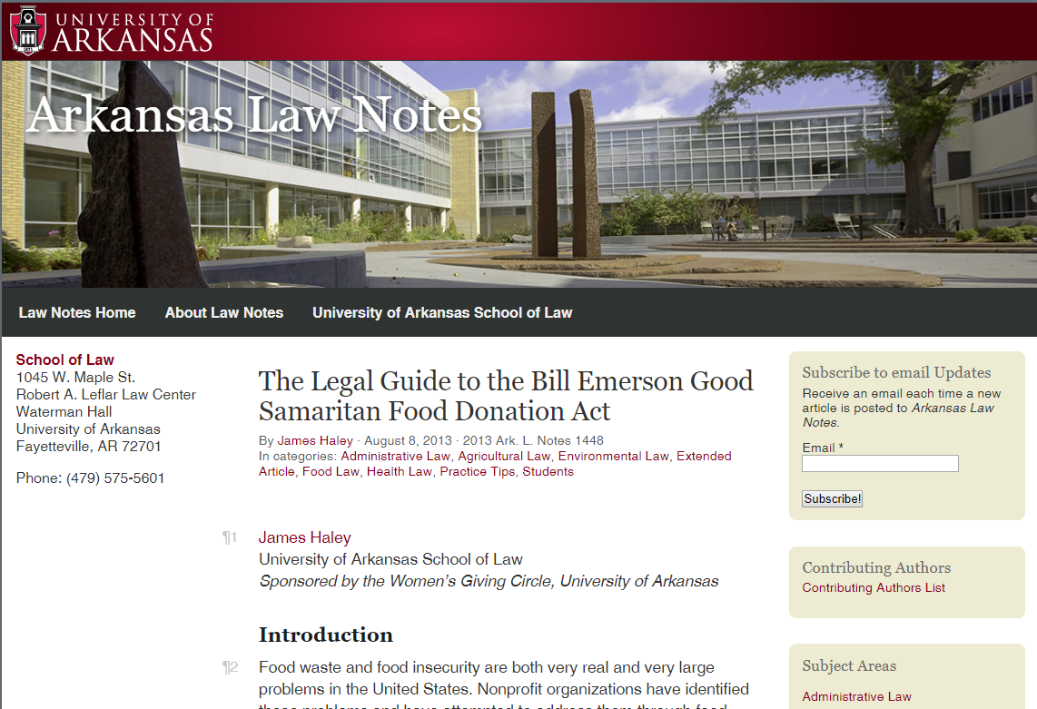
Good Samaritan Food Donation Act
Source of middle article:
http://media.law.uark.edu/arklawnotes/2013/08/08/the-legal-guide-to-the-bill-emerson-good-samaritan-food-donation-act/
University of Arkansas School of Law – James Haley, Aug 8, 2013
Notes:
Food recovery can serve a primary goal of reducing hunger and a secondary goal of “not feeding the landfill.”
Unfortunately, many are not aware of the 1996 Bill Emerson Good Samaritan Food Donation Act and the protections that it provides donors; some potential donors even believe it is illegal to donate food and grocery items. 21 years after its passage, the Act remains an underutilized tool.

Slide 11
Feed Animals
Provide to area farms and zoos
Vegetable trimmings
Post-consumer plate waste
Barriers
Some states ban food donation for animal feed
Strict diets in corporate operations

Slide 12
Industrial Uses
Anaerobic digestion for energy recovery
Biofuels from waste oils
Notes:
Wasted food can be turned into energy

Slide 13
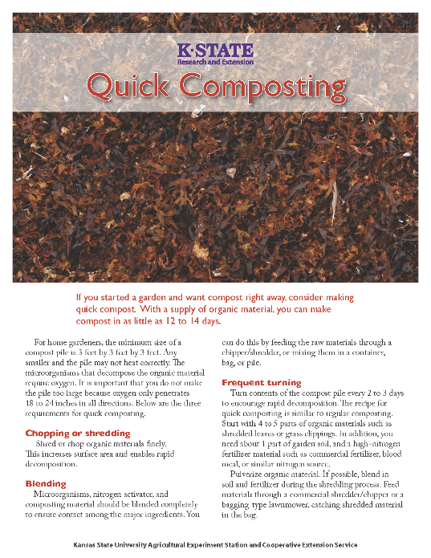
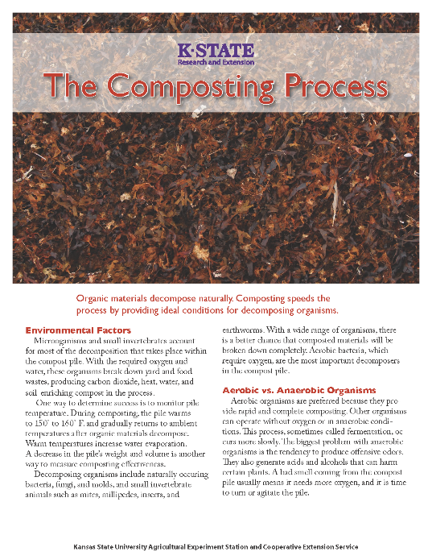
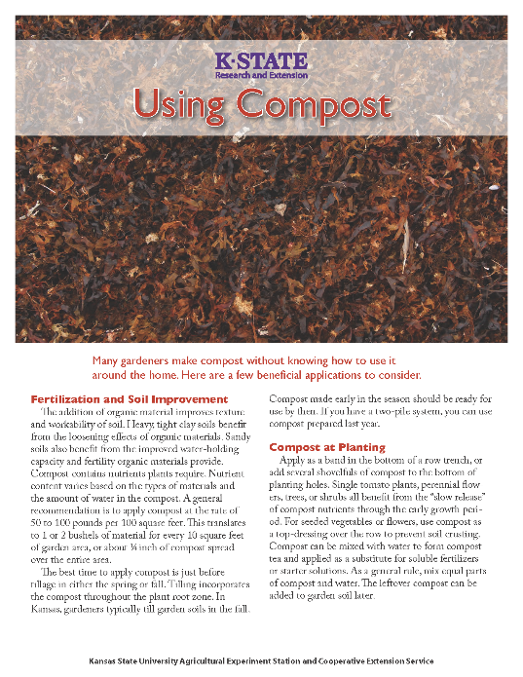
Composting
Creates a nutrient-rich soil amendment
Barrier - Lack of commercial composting facilities
Backyard composting is a good option!
Notes:
…(Or food waste recycling) While the industrial uses and composting strategies don’t offer the cost savings and environmental benefits of food waste prevention or the social benefits of food donation, they are still useful for deriving value and nutrients from food scraps.
Missouri Organic Recycling - https://www.missouriorganic.com/food-waste-recycling/ picks up in the KC and Lawrence areas
As food scraps in landfills decompose, they produce methane, a potent greenhouse gas. By contrast, properly managed composting is not a major source of methane. Discuss backyard composting.

Slide 14
Landfilling
Last resort!

Slide 15
EPA Food: Too Good to Waste Tool
Implementing a campaign in your community

Slide 16
Food: Too Good to Waste Campaign
Goal: to prevent household wasted food
Main message: food is too essential to throw away
Implementation guide and tool kit
Behavior change tools
Outreach tools
https://www.epa.gov/sustainable-management-food/food-too-good-waste-implementation-guide-and-toolkit
Notes:
The Goal is to prevent household wasted food. EPA has another program called the Food Recovery Challenge that’s geared for businesses and institutions
The premise behind the FTGTW campaign is that by making small changes in our food management behaviors, we can have a large impact, both for ourselves and for the environment and our communities. When we make small changes in how we shop, prepare and store food…. we can waste less, save money, and keep the valuable resources used to produce and distribute food from going to waste.
The campaign is relatively simple. You as the community leader, decide on food waste objectives; you select the group you want to target; You give the audience compelling reasons to waste less food; then give them some tools to accomplish it. EPA’s FTGTW tool consists of an implementation guide and tool kit. The tool kit has behavior change and outreach tools

Slide 17
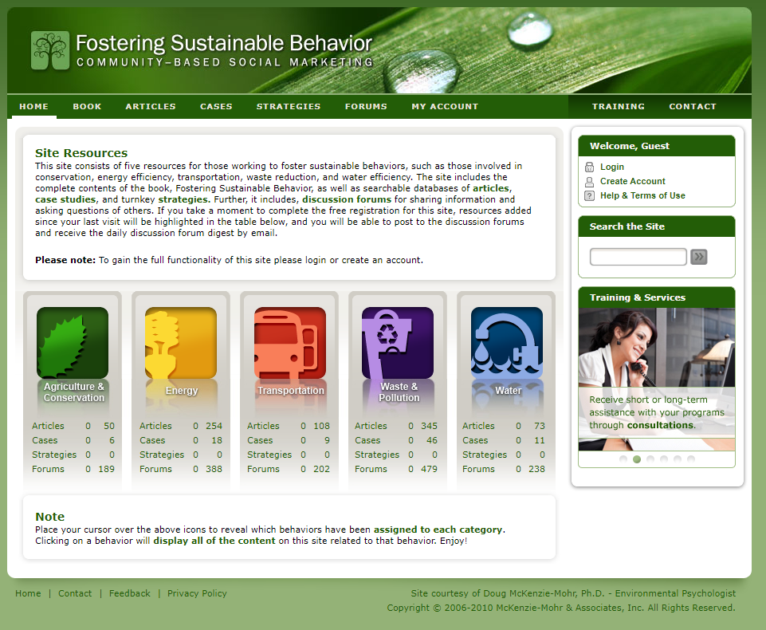
Five step of community-based social marketing
Selecting behaviors
Identifying barriers & benefits
Developing strategies
Conducting a pilot
Broad-scale implementation
www.cbsm.com
Notes:
The FTGTW tools uses CBSM principles. CBSM is an approach to driving behavioral change through community initiatives. These initiatives remove barriers to desired behaviors, while enhancing the benefits to the desired behaviors.
This slide is a screen shot of the website, Fostering Sustainable Behavior, Community-based social marketing
(Show book, Fostering Sustainable Behavior by Doug McKenzie-Mohr). One of the main messages is information alone does not change behavior.
Read where marked in book. Book is available online. It introduces the five steps…
From the book: Community-based social marketing…
(Look at 5 steps. #2 next)

Slide 18
Benefit - We all hate waste
Photo from EPA FTGTW tool slides
Notes:
Slide from EPA FTGTW tool. It is somewhat a mystery why we waste so much especially since relatively recent brain research shows that we really dislike waste, especially when it is something that we consider ours. They termed it: loss aversion. Essentially, we are wired to hate losing the resources we have in hand. So the good news here is that we have an in‐built motivation to waste less!
Explanation of loss aversion: Losses are more powerful behavioral motivators than gains. Owning something increases its value. Losing $100 worth of food has a greater impact on how satisfied we are than saving $100 on food.
Source: Thaler and Sunstein, 2008, Nudge: Improving Decisions about Health, Wealth and Happiness; Kahneman, 2011, Thinking, Fast and Slow

Slide 19
Barrier – Brain on automatic
Source: Cornell University Food and Brand Lab
Notes:
Slide from EPA FTGTW tool. Still, there must be other things at play. One is we often act automatically instead of reflecting on what we are doing.
For example, you are likely to serve yourself more if your plate is bigger or if the color contrast between the plate and the food is low. In this picture, the green plate has more beans than the orange plate. Serving more food can lead to not finishing what’s on our plates and plate waste.
Our brains are often on automatic when we do routine tasks such as shopping and clean‐ up after meals, so we might forget what leftovers we have in the refrigerator or that we still have tomatoes in the refrigerator from the last time we went to the store.
Source: Cornell University Food and Brand Lab

Slide 20
Barrier – Dynamic lifestyles
Artist: Beverly Naidus
Notes:
Slide from EPA FTGTW tool. Another big culprit in wasted food is our dynamic lifestyles.
Planning is one thing and following through on plans is another. We want to eat nearby or have work commitments. Both of these may take precedence over going home to cook that meal you planned on.
A study by the Cornell University Food and Brand Lab found that 93 percent of respondents acknowledged buying foods they never used.

Slide 21
Additional Barriers
Not enough information
Time needed to learn new skills
Time needed to prepare fresh food
Food preferences
Notes:
While researchers can point to some general behaviors leading to wasting food, for different families there will be different barriers to reducing food waste. Feeding a household is a complex series of activities. There’s meal planning, shopping, storing, preparing and cooking food as well as choosing what to eat at any given moment.
Some of the barriers to making changes in how we carry out these activities are:
not having enough information to make a change,
a lack of time, and
food preferences. Children especially can favor one type of food over another and though you try to get them to eat food that is good for them, it seems that just as often its still on the plate at the end of the meal.

Slide 22
Additional Benefits
Saving money
Keeping fruit and vegetables fresh longer may increase their consumption
By trying different ways to buy and prep food, we can simplify our lives
Basic satisfaction that comes from wasting less
Notes:
In addition to having a built-in aversion to waste, other benefits of keeping good food from going to waste include

Slide 23
The Toolkit

Slide 24
Campaign Strategies & Behavior Change Tools
Strategy | Benefits | Barriers
Get Smart: See how much food (and money) you are throwing away | Waste aversion | Time Dynamic lifestyle Automatic behavior
Smart Shopping: Buy what you need | Waste aversion Saving $ | Time Dynamic lifestyle Automatic behavior
Smart Storage: Keep fruits and vegetables fresh | Waste aversion Health Saving $ | Knowledge Time Not enough room in fridge
Smart Prep: Prep now, eat later | Convenience Saving $ Health | Skills Knowledge
Smart Saving: Eat what you buy | Waste aversion Saving $ | Gratification Convenience
Notes:
The FTGTW Toolkit identifies five behavior changes that have significant potential to reduce wasted food in households. The Toolkit identifies strategies to achieve these behavior changes, and it provides tools based on the strategies to help people make the behavioral changes.
------
Get Smart purpose: Actively engage participants in learning about how they manage food in their household; measuring progress
Smart Shopping: Encourage participants to plan their food needs ahead of time and only purchase what they will use
Smart Storage: Provide information for participants to safely store their food so it is good for the meals they planned
Smart Prep: Provide tips on saving time in the kitchen by preparing foods ahead of time
Smart Saving: Visually remind participants to eat foods while they are fresh

Slide 25
Campaign Strategies & Behavior Change Tools
(cont.)
Strategy | Tool | Action | Purpose
Awareness and Education | Fact Sheet: “Consider the Tomato” | Outreach | Educate participants and potential participants
Awareness and Education | Workshop Presentation | Outreach | Educate participants and potential participants
Notes:
Two additional outreach tools are included to support the general strategy of raising awareness and education.

Slide 26
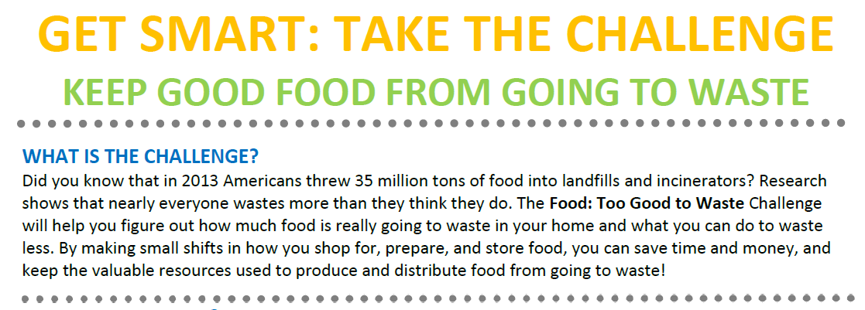
Get Smart:
Track wasted food
Tool provides instructions and worksheets
Measure by volume, weight, or both
Consider providing scales
Most challenges are four to six weeks
Two weeks to establish baseline, four weeks to test strategies and create new habits
Measure preventable and/or non-edible wasted food
Notes:
Waste aversion is a strong psychological motivator, but most households are not aware of how much they waste and may even question if they waste food.
The Get Smart: Take the Challenge tool consists of instructions and worksheets for households to collect and measure how much food they waste over the course of, ideally, a six week challenge. This is the tool that will raise awareness on how much food is going to waste.
Depending on the goals of the Challenge, wasted food may be defined to include both
preventable and non-edible wasted food (egg shells, bones, fruit pits, and non-edible peels.), or only preventable wasted food.
Purpose: Actively engage participants in learning about how they manage food in their household; measuring progress

Slide 27
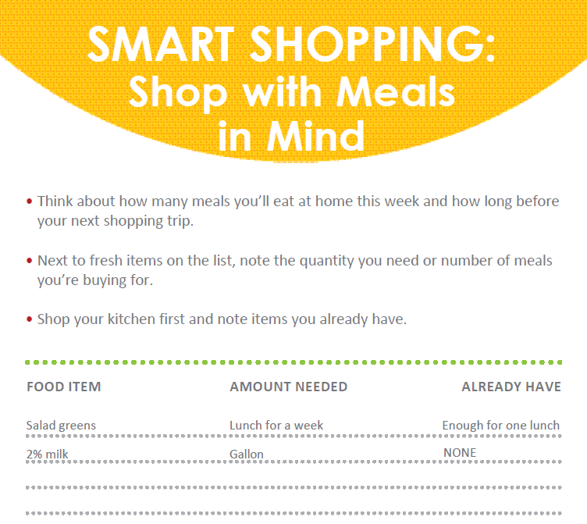
Smart Shopping: Buy What You Need
Template for making shopping lists
Encourages meal planning; simplifies food management
Creates awareness of amount of food needed for meals
“Shop your kitchen first”
Notes:
Smart Shopping: Shop With Meals in Mind
The objective in making a shopping list with meals in mind is both to check what you already have on hand, what they call “shopping your kitchen first” but also to consider how many meals you will be likely to eat at home before you next go shopping and buy accordingly.
By making a list with meals in mind, you will waste less, eat better, and save time and money.
This strategy also focuses on buying only the quantities you need until your next shopping trip. The effort here is to be aware when you are shopping how much you are putting in your cart rather than being on autopilot when shopping. By buying no more than what you expect to use, you will be more likely to use it up and keep it fresh.
Purpose: Encourage participants to plan their food needs ahead of time and only purchase what they will use

Slide 28
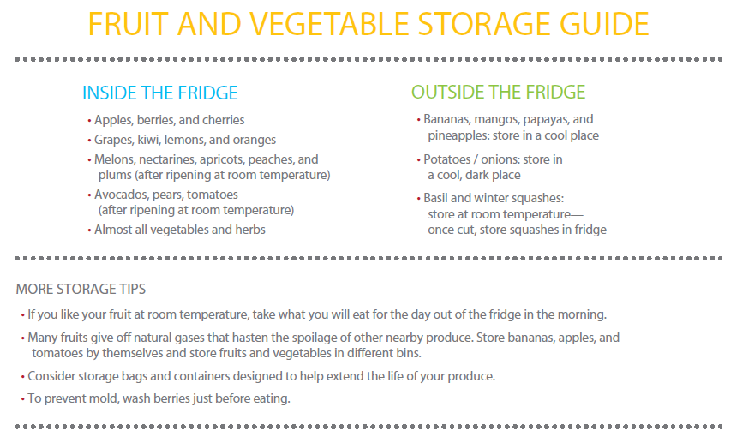
Smart Storage: Fruit and Vegetable Storage Tips
Visual prompt – remind how to keep produce fresh
Suitable for posting on the refrigerator
Can be distributed at tabling/community events
VT flyer (how to use the crisper drawer humidity settings)
Notes:
This tool is a visual prompt to remind participants how to keep produce fresh. Prompts are particularly useful when designed to engage people in positive behaviors and presented in close proximity to where the action takes place. (Dillons with reminder on signs in parking lot to bring canvas bags.)
The prompt provides useful information on keeping produce fresh.
It is printed in bright colors on a half sheet suitable for posting on the refrigerator.
The prompt can also be distributed at tabling and community workshop events. In FTGTW pilots many households found this guide to be very effective.
Purpose: Provide information for participants to safely store their food so it is good for the meals they planned

Slide 29
Smart Prep: Prep Now, Eat Later
Notes:
The Smart Prep: Prep Now, Eat Later strategy provides consumers helpful tips on preparing perishable foods soon after shopping (like right after you get home). This strategy helps with busy lifestyles. By preparing perishable foods post‐shopping, you’ll make it easier to whip up meals later in the week, saving time, effort and money.
Purpose: Provide tips on saving time in the kitchen by preparing foods ahead of time

Slide 30
Smart Saving: “Eat First”
Eat what needs eating first.
Notes:
The final strategy is to eat what needs eating first. The "Eat First" tool is designed as a visual prompt. Households are encouraged to designate an area in the refrigerator for food that should be eaten relatively soon like aging ingredients and leftovers.
Another way to eat what needs eating first is to learn flexible recipes. Casseroles, frittatas, soups, stir-frys, and smoothies are great ways to use leftovers, and odds and ends.
Purpose: Visually remind participants to eat foods while they are fresh

Slide 31
Awareness and Education Fact Sheet: “Consider the Tomato”
Designed to attract attention/raise awareness
Tells a story about why wasted food matters
Provides context for wasted food as an environmental and economic issue
Formatted as a poster
Notes:
We just looked at five behavior change strategies and tools. Now we will look at two Outreach tools.
Formatted as a poster so could be used as a conversation starter; messaging is important

Slide 32
Awareness and Education: Workshop Presentation
Designed for FTGTW campaign organizers
Introduce the campaign and tools to community members
Recruit participants
Notes:
The Workshop Presentation tool is designed for FTGTW campaign organizers to use to make presentations at workshops or community meetings. The presentation can be used to introduce the FTGTW campaign and the tools to community members and to recruit participants. Will post.

Slide 33
Implement a small-scale campaign
Five step of community-based social marketing
Selecting behaviors
Identifying barriers & benefits
Developing strategies
Conducting a pilot
Broad-scale implementation
Notes:
Review the CBSM principles. Next is implement a pilot.

Slide 34
Steps to Implementation
Step 1 – Design the (small scale) campaign
Step 2 – Adapt the FTGTW tools
Step 3 – Conduct outreach and recruitment
Step 4 – Monitor and support; increase retention
Step 5 – Data collection
Step 6 – Analyzing and sharing results
Notes:
Two principal target populations were selected in crafting the campaign messaging and strategies in EPA’s pilot: (1) families with young children and (2) young adults (of ages approximately from 18 to 30). The two principal target populations were chosen on the basis of previous research that indicated these two demographics generate the largest amounts of wasted food in households.

Slide 35
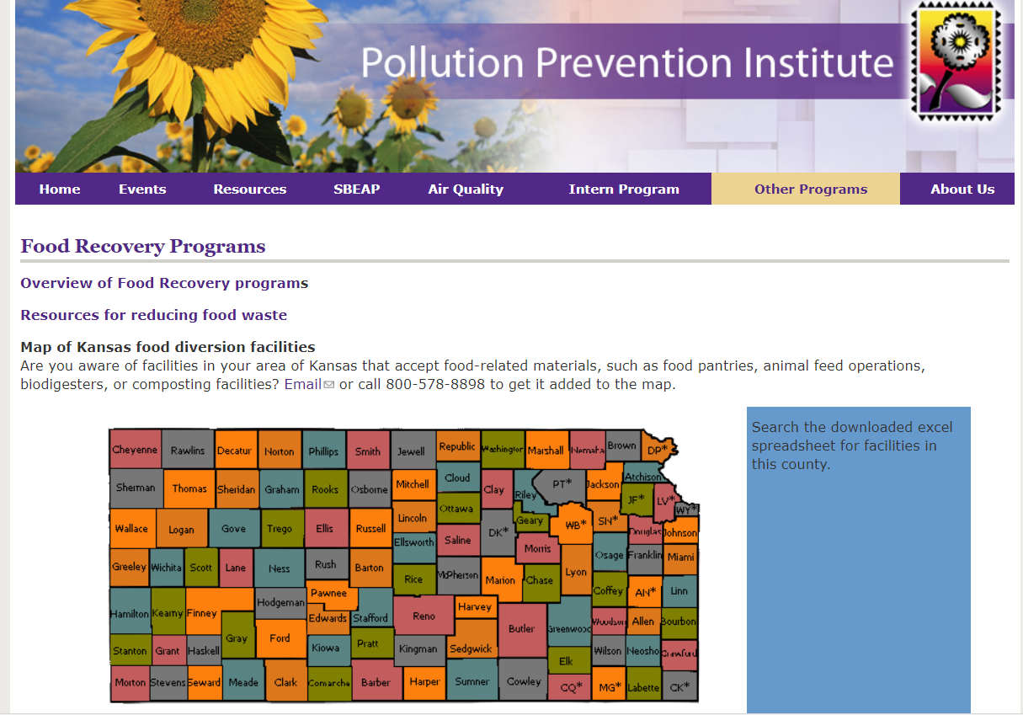
Food recovery resources (www.sbeap.org)

Slide 36
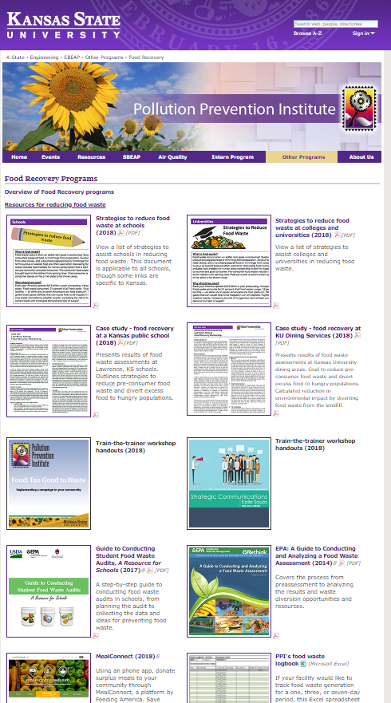
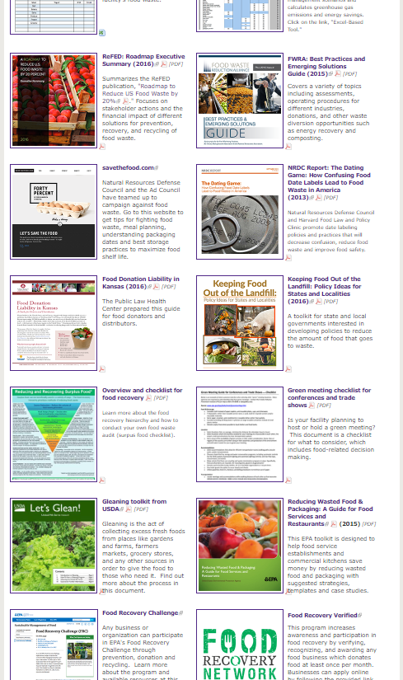
Additional resources (www.sbeap.org)

Slide 37
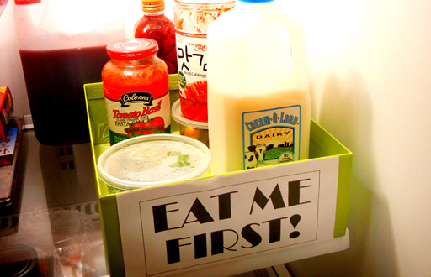
Questions?
Nancy Larson
nlarson@ksu.edu
Lynelle Ladd
lladd@ksu.edu
800-578-8898

Slide 38
Love Letter to Food
Notes:
If time…https://www.foodpolicy.umn.edu/files/love-letter-food

