Slide 1
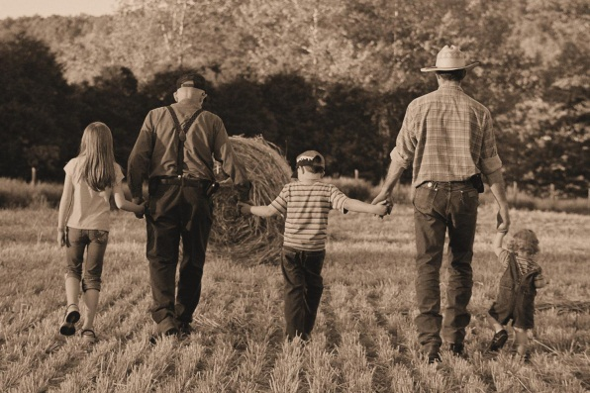
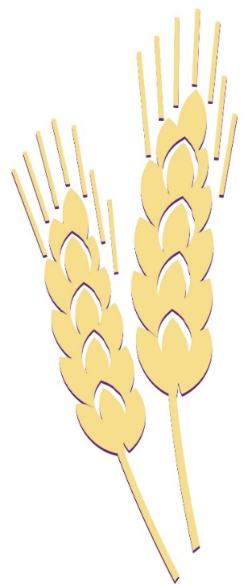


Succession Planning Overview
Gregg Hadley, PhD
Assistant Director – Agriculture, Natural Resources, and Community Development
K-State Research and Extension
ghadley@ksu.edu
785-532-5838

Slide 2
Why?

Slide 3
Grandma and Grandpa
(The Past Generation)
The Brothers’ and Sisters’ Kids (The Future)
Mom and Dad
(The Current Generation)
The Brothers’ and Sisters’
Spouses
Farming Brother and Sister (The Next Generation)
Non-Farming
Brother and Sister

Slide 4
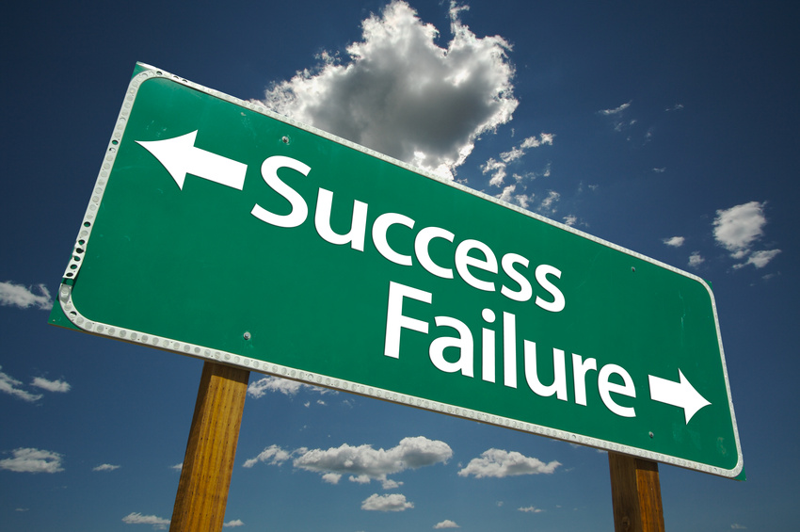

Slide 5
What is Success?

Slide 6
An Ongoing Farm & A Happy Family

Slide 7
Rules & Promises

Slide 8
What is Succession Planning?
Commonly used terms
  Transition planning
  Estate planning
  Succession planning

Slide 9
Transition Planning
Refers to planning for any change
  Expansion
  Contraction
  New technology

Slide 10
Estate Planning
Refers to how assets will be passed on to heirs

Slide 11
So, What is Succession Planning?

Slide 12
Estate Planning
& Succession Planning
My perspective
  Estate Planning is about how assets will be transferred to heirs
  Succession Planning involves discussing so much more:
    Estate planning
    Establishing the business philosophy rights
    Leadership, management and workload rights
    Determining how the partners will work and communicate together
    Succession feasibility

Slide 13
Estate Planning is One Piece of the Succession Planning Pie

Slide 14
Do You Need a Detailed Succession Plan?

Slide 15
Test Questions to Determine if You Need Succession Planning
Current owners & managers:
  Do you always agree with your successor’s business philosophy, management ideas and decisions?

Slide 16
Test Questions to Determine if You Need Succession Planning
Future owners & managers:
  Do you always agree with the current owner/manager’s business philosophy, management ideas and decisions?

Slide 17
If You Said No, You are Honest
and Need Succession Planning

Slide 18
If You Said Yes, You are Probably a Liar or Kidding Yourself!

Slide 19
Most successions fail due to the lack of a good estate plan
A Common Belief

Slide 20
Not Always
Disagreements about business philosophy
Inadequate earning capability
Transfer of work and management decision making
Emotional roadblocks
Poor communication
Death, disease, disability, disaster, divorce (5 Ds)
Poor estate plans

Slide 21
Most Farm and Ranch Situations Require a Detailed Succession Plan

Slide 22
What are the Steps in Succession Planning?

Slide 23
Succession Steps
Succession Participants
Succession Facilitators
Concern | Step
Estate Plan | 1
Financial Feasibility | 2
Business Plan | 3
Dealing with Emotional Roadblocks | 4
Learning how to Communicate and Teambuilding | 5
Concern | Step
Estate Plan | 5
Financial | 4
Business Plan | 3
Dealing with Emotional Roadblocks | 2
Learning how to Communicate and Teambuilding | 1

Slide 24
Who Should Be Involved in Succession Planning?

Slide 25
Grandma and Grandpa
(The Past Generation)
The Brothers’ and Sisters’ Kids (The Future)
Mom and Dad
(The Current Generation)
The Brothers’ and Sisters’
Spouses
Farming Brother and Sister (The Next Generation)
Non-Farming
Brother and Sister

Slide 26
So, When Should I Begin Succession Planning?

Slide 27
Today!
On-going process
The actual succession plan should be developed before the next generation starts working for the farm in a career position
The plan should be reassessed frequently
Never know when one of the 5 Ds will hit

Slide 28
It Can Be A Lengthy Process
Succession Planning Meeting | Meetings Required (1/2 Day Meeting)
Team building | 1 to 2 Meetings
Communications | 1 Meeting
Conflict management | 1 Meeting
Business philosophy and strategy Issues | 1 to 3 Meetings
Operational issues | 1 to 3 Meetings
Financial issues | 1 to 2 Meetings
Decision making and work responsibility transition map | 1 to 2 Meetings
Estate planning | 1 to 4 Meetings
Plan finalization | 1 to 2 Meetings

Slide 29
Succession Planning Can Be Stressful!

Slide 31
Start Today! It Is So Worth It!

Slide 33
Thank You!
Good Luck With Your Farm or Ranch Succession!

