Slide 1



Communication & Family Dynamics
Charlie Griffin, M.S.
Charlotte Shoup Olsen, Ph.D., CFLE

Slide 2
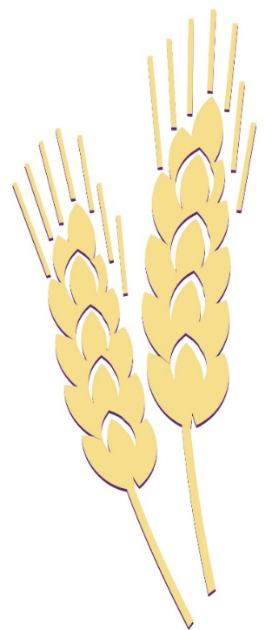
Complexity of Family Business
Return on
investment,
transfer of
assets
Security
fun
nurturing
Family/
Personal
System
Ownership
System
Management
System
Productivity, day-to-day operations

Slide 3
“The future of agriculture lies in the hands of young and beginning farmers. We need to find more ways to help them take the reins of the farm business.“
  - Canadian Agriculture Minister Gerry Ritz

Slide 4
“Transitioning the older generation from the business is one of the top challenges facing North American Agriculture.”
        Dave Kohl and Alicia Morris
        Virginia Cooperative Extension

Slide 5
“Ranchers and farmers are telling us their weakest link is not technology nor information. Their weakest link is human relationship management.”
-Robert Fetsch, Colorado State University Cooperative Extension

Slide 6
5 Areas of Risk that Threaten
Family Farms
  Financial
  Legal
  Marketing
  Production
  Human Resources

Slide 7
Challenges to Family Businesses
The separation of authority from ownership and management.
Issues of unfairness in the successor generation.
Absence of a shared sense of purpose.
Communication problems.
Lack of formal structures and processes that manage decision-making.
Neglect of individual, family and organizational development (Aspen Family Business Group, 2004).

Slide 8
Common Sources of Farm Family Conflict
Control
Transfer of property/ownership
Division of income…fairness?
Obligations, debts,
and risks
In-law relations and competing loyalties
Coping differences
Decision making

Slide 9
Farm Transition Planning
Much more than estate planning!
Weaving of Family Life Cycle with Business Life Cycle
Combines:
- Career Development Plan
- Professional Development
- Retirement Plan

Slide 10
Economic Considerations
Profitability
  Pointless to talk about transferring a systematically unprofitable farm or ranch
Feasibility
  Can we make the payments on proposed expansion plans?
Size
  Is the business large enough to accomplish goals?

Slide 11
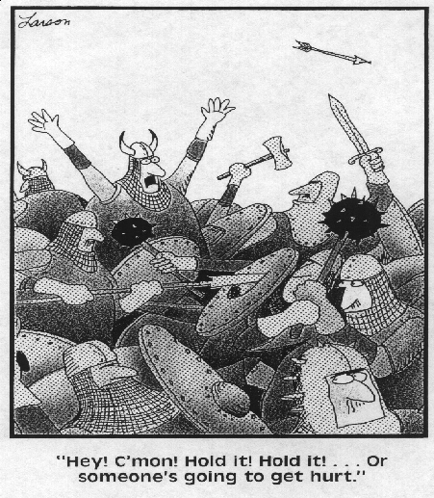

Slide 12
The Important Point…
These decisions are not independent.
All decisions regarding the “structure” of the business need to be made simultaneously, and at the early stages of the planning process….and perhaps again at major transition points.

Slide 13
Getting What You Want From Your Family Farm Life
What is most important about having a farm?
What do you value about family life?
What issues do you have with other family members? What conflicts are unresolved?
What do you want to be different in your relations with other family members?
What do you want to stand for and preserve as a family?
What issues does the farm business need to address in the next ten years that will significantly impact the family and me?

Slide 14
What’s Your Role in the Farm?
Board of Directors?
Vice President – Upper Level Management?
Division Director?
Labor? Hourly? Salaried? Don’t know?
Investor / Stockholder? (Heir?)
How are each of these positions affected by off farm work?
Learn to stay in your lane!

Slide 15
Management Principles for a Family Business
Shared values
Shared power
Shared expectations
Shared activities for maintaining relationships
Traditions
Willingness to learn and grow
Genuine caring and support each other
Mutual respect
Privacy and well-defined interpersonal boundaries
- Dennis Jaffe, “Working With The Ones You Love”

Slide 16
More About General Communication
How do I get someone to communicate differently?
The only thing you can change is how
YOU communicate
  How YOU listen
  How YOU act
  How YOU react
  How YOU interact

Slide 17
The Big R
RESPECT

Slide 18
“Words don’t just come out of our mouths and disappear. Rather, they’re a very important means of connecting and have lasting effects and consequences. We need to be mindful of how we speak.”
-Author Unknown

Slide 19
BUT, how you say it counts more than WHAT you say!
7% WORDS
38% TONE OF VOICE
55% BODY LANGUAGE
100% TOTAL MESSAGE
WHAT
HOW

Slide 20
Thinking Critically About Our Nonverbal Messages
Analyze your own nonverbal behavior.
Observe. Observe. Observe.
Resist temptation to draw conclusions from nonverbal behaviors.
Connect and relate.

Slide 21
How to Become a More Effective Listener
Always show respect for the speaker.
Know when to be a passive listener.
Know when to be an active listener.
  Paraphrase the speaker’s meaning.
  Express understanding of speaker’s feelings.
  Ask questions.

Slide 22
Three Ways to Respond to Bids for Communication
Turning—toward responses.
Turning—away responses.
Turning—against responses.

Slide 23
YOU

Slide 24
One More Thing…
Remember to enjoy each other and to regularly show appreciation to each other (in the way the other person likes)!!

Slide 25
And Another Last Thing!
Two Surprisingly Simple Truths for Married Couples
Happily married couples behave like good friends.
Happily married couples handle their conflicts in gentle, positive ways.

Slide 26
CONTACT INFORMATION
Charlie Griffin, M.S., Research Assistant Professor
School of Family Studies and Human Services
Programs for Workplace Solutions, A211 Edwards Hall
Phone: 785-532-2025
Email: cgriffin@k-state.edu
Charlotte Shoup Olsen, Ph.D., CFLE
Family Systems Specialist, K-State Research & Extension
Family Studies & Human Service
Phone: 785-532-5773
Email: colsen@k-state.edu
Kansas State University
Manhattan, KS 66506

